Slide 1
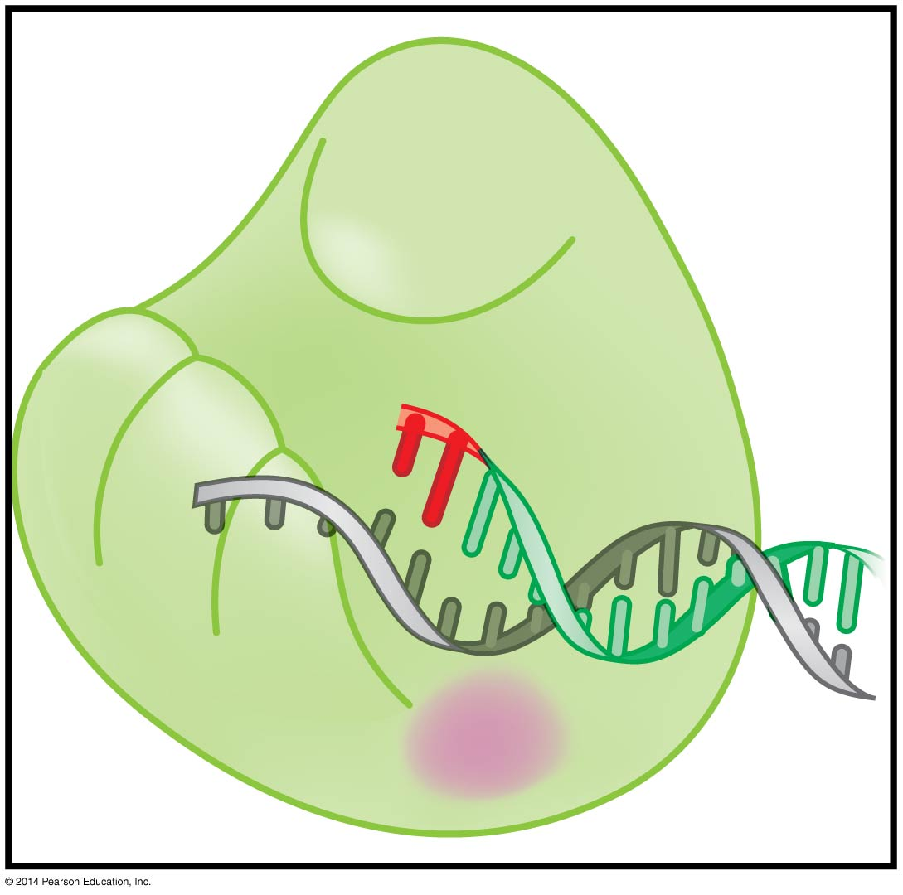
The replication of DNA
BT 451
Chapter 9

Slide 2
The chemistry of DNA synthesis

Slide 3
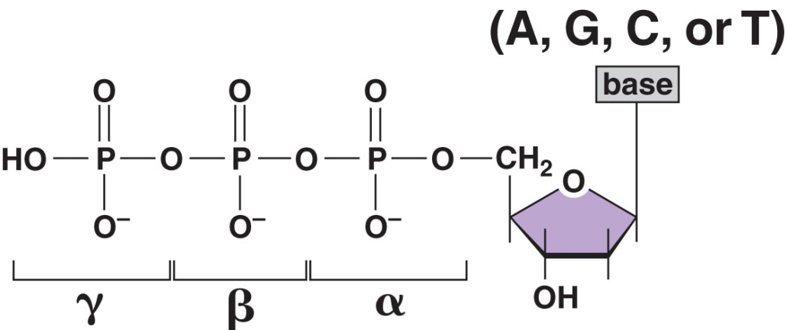
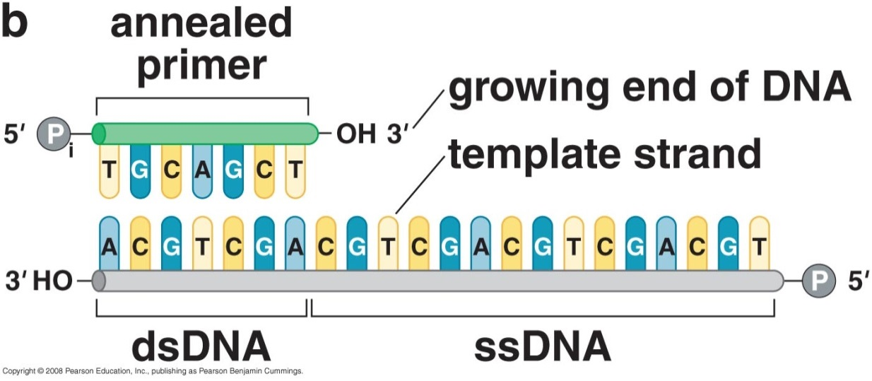
DNA synthesis needs:
Deoxinucleoside triphosphate (dNTP)
Primer : template junction

Slide 4
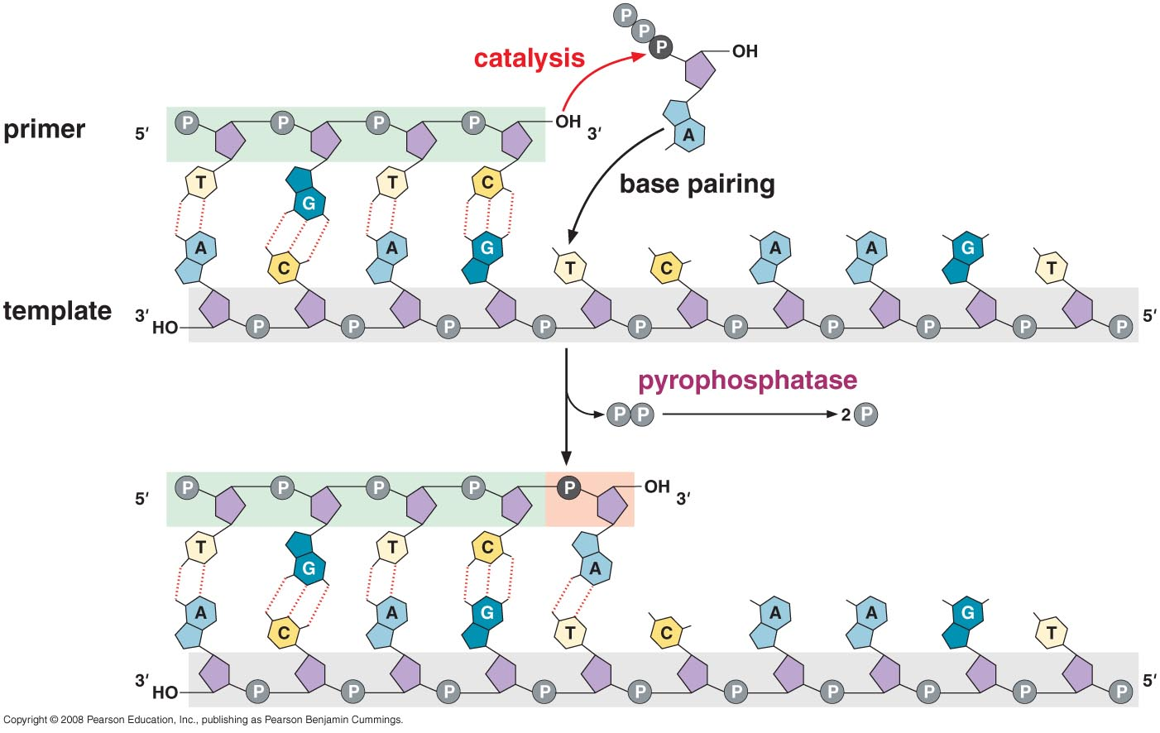
XTP + (XMP)_{n} → (XMP)_{n+1} +P~P
Hydrolysis of pyrophosphate is the driving force for DNA synthesis
Notes:
XTP + (XMP)_{n} → (XMP)_{n+1} +2 Pi
Delta G = -7 kcal/mol
Keq = 10⁵

Slide 5
The mechanism of DNA polymerase
Uses single site to catalyze the addition of the 4 nucleotides (identical geometry of the A:T and G:C base pairs)
It monitors the ability of the incoming nucleotide to form an A:T or G:C base pair, rather than detecting the exact nucleotide that enters the active site
Only when a correct base pair is formed are the 3’-OH of the primer and the α-phosphate of the incoming nucleotide in the optimum position for catalysis to occur.
Rate of incorporation of incorrect nucleotide is 10,000-fold slower than incorporation when base pairing is correct

Slide 6
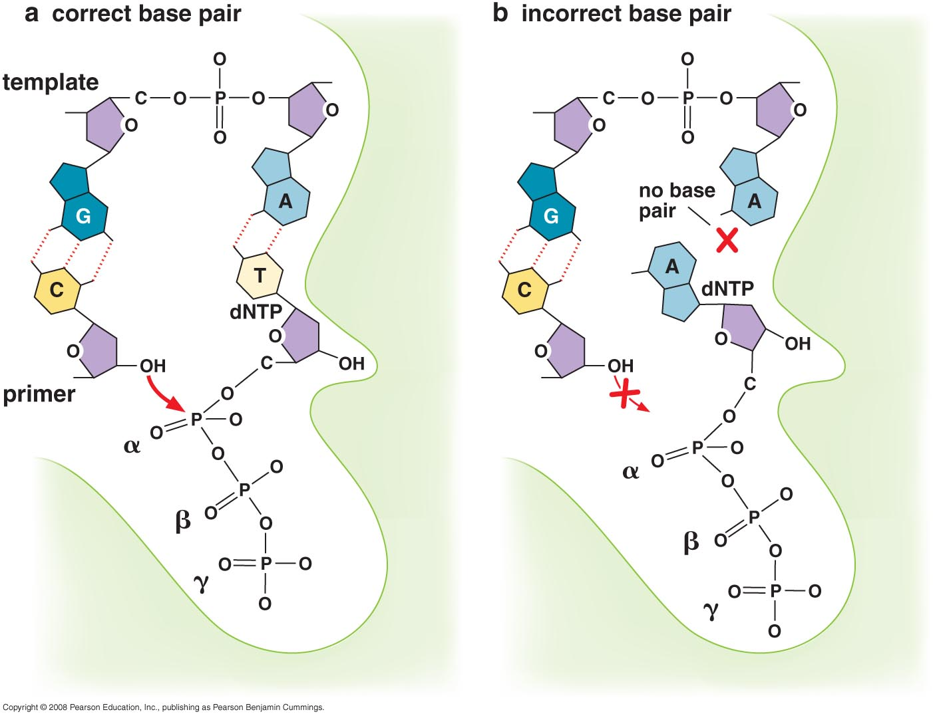

Slide 7
This discrimination is mediated by the steric exclusion of rNTPs from the DNA polymerase active site
Can recognize dNTP from rNTP by discriminator amino acids
The nucleotide-binding pocket is too small to allow the presence of a 2’-OH on the incoming nucleotide
This space is occupied by the two amino acids that make van der Waals contacts with the sugar ring

Slide 8
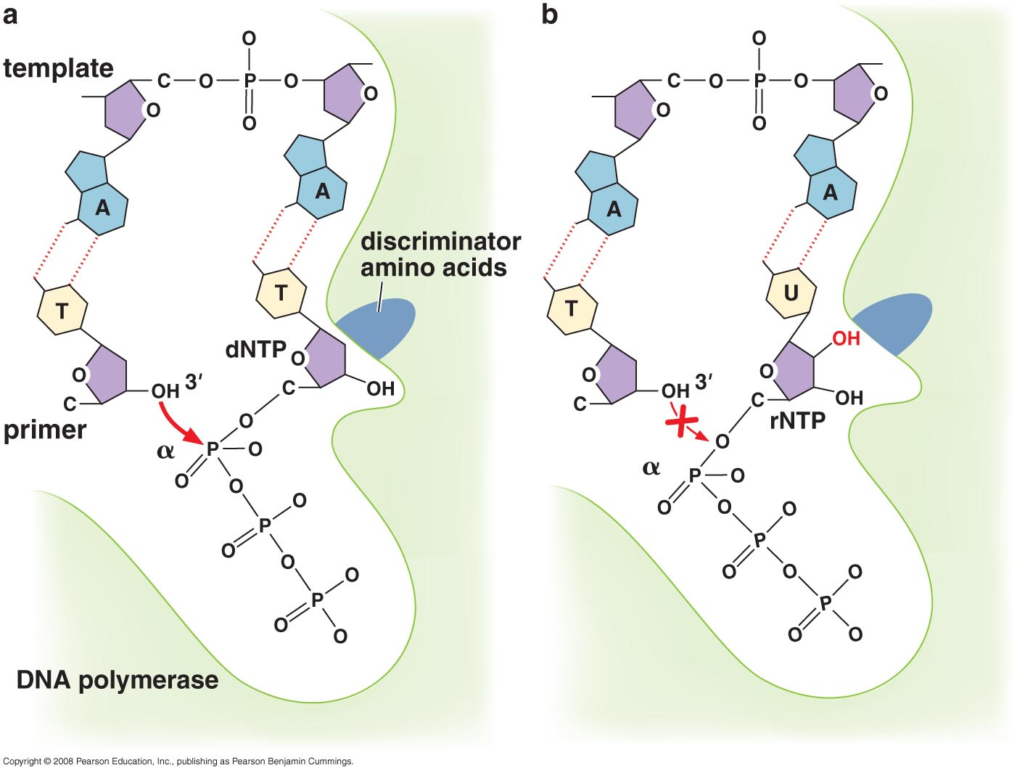

Slide 9
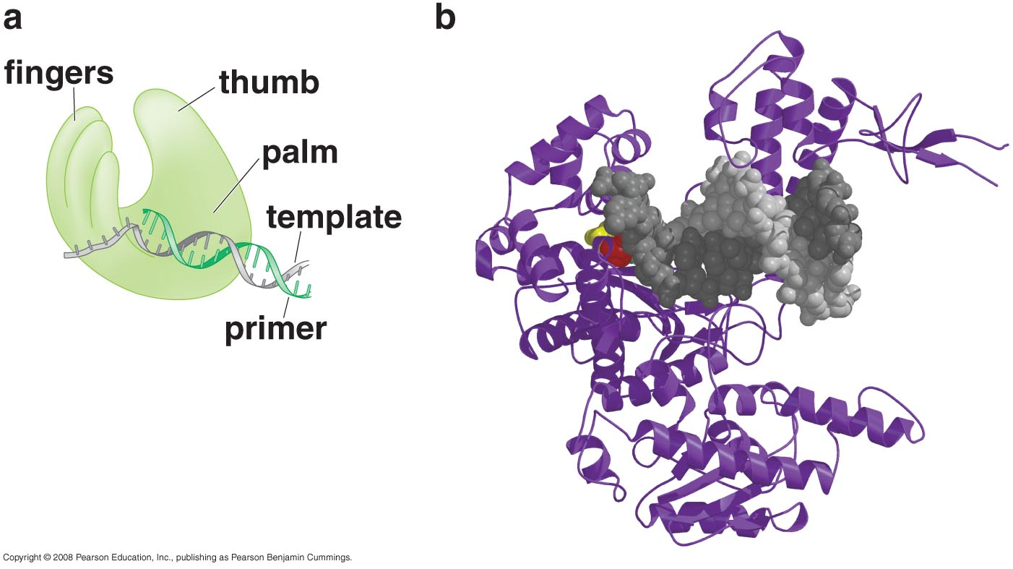
DNA polymerase structure

Slide 10
Palm
β-sheet, has the primary elements of the catalytic site, binds two metals ions (Mg²⁺ or Zn²⁺)
One metals ion reduces the affinity of the 3’-OH for its hydrogen. This generates a 3'O⁻ that is primed for the nucleophilic attack of the α-phosphate of the incoming dNTP
The second ion coordinates the negative charges of the β-phosphate and γ-phosphates of the dNTP and stabilizes the pyrophosphate produced by joining the primer and the incoming nucleotide
Monitors the base pairing of the most recently added nucleotide

Slide 11
Fingers
Several residues in the fingers bind the incoming dNTP
Once a correct base pair is formed between the incoming dNTP and the template, the finger domain moves to enclose the dNTP
Notes:
1- Move to enclose dNTP once correct base is bounded, hence it becomes closer to metal ions in the palm which will lead to faster reaction
2- Bend template strand 90° immediately after active site, hence no confusion of which base is involved in the reaction

Slide 12
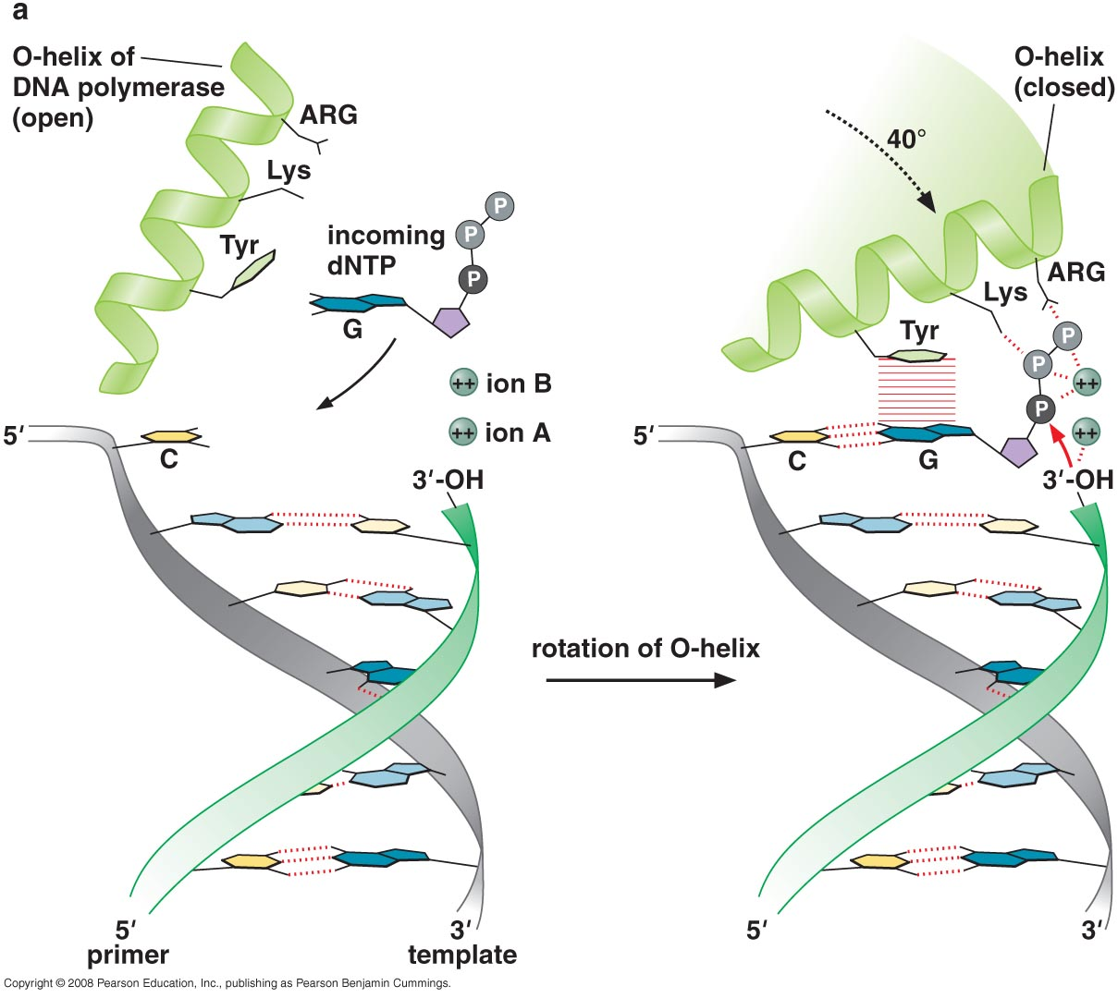

Slide 13
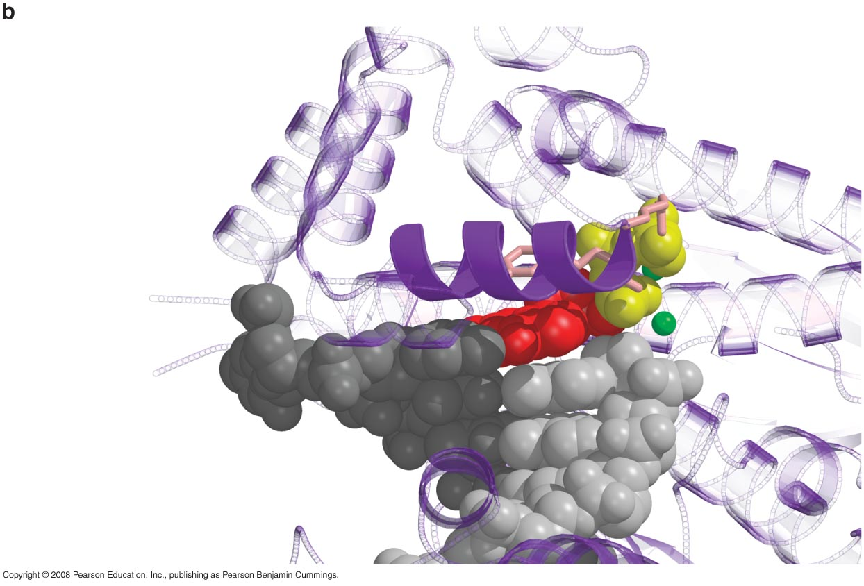
3D structure of the active-site metal ions associated with the T7
DNA polymerase, the 30-OH end of the primer, and the incoming nucleotide.
Notes:
O-helix: purple; base and deoxyribose of incoming dNTP: red; primer: light gray; template: dark gray; two catalytic ions: green; phopshates: yellow; tyrosine, lys, arg: pink

Slide 14
The finger domain associates with the template region, leading to a nearly 90° turn of the phosphodiester backbone between the first and second bases of the template.
This bend serves to expose only the first template base after the primer at the catalytic site and avoids any confusion concerning which template base should pair with the next nucleotide to be added

Slide 15
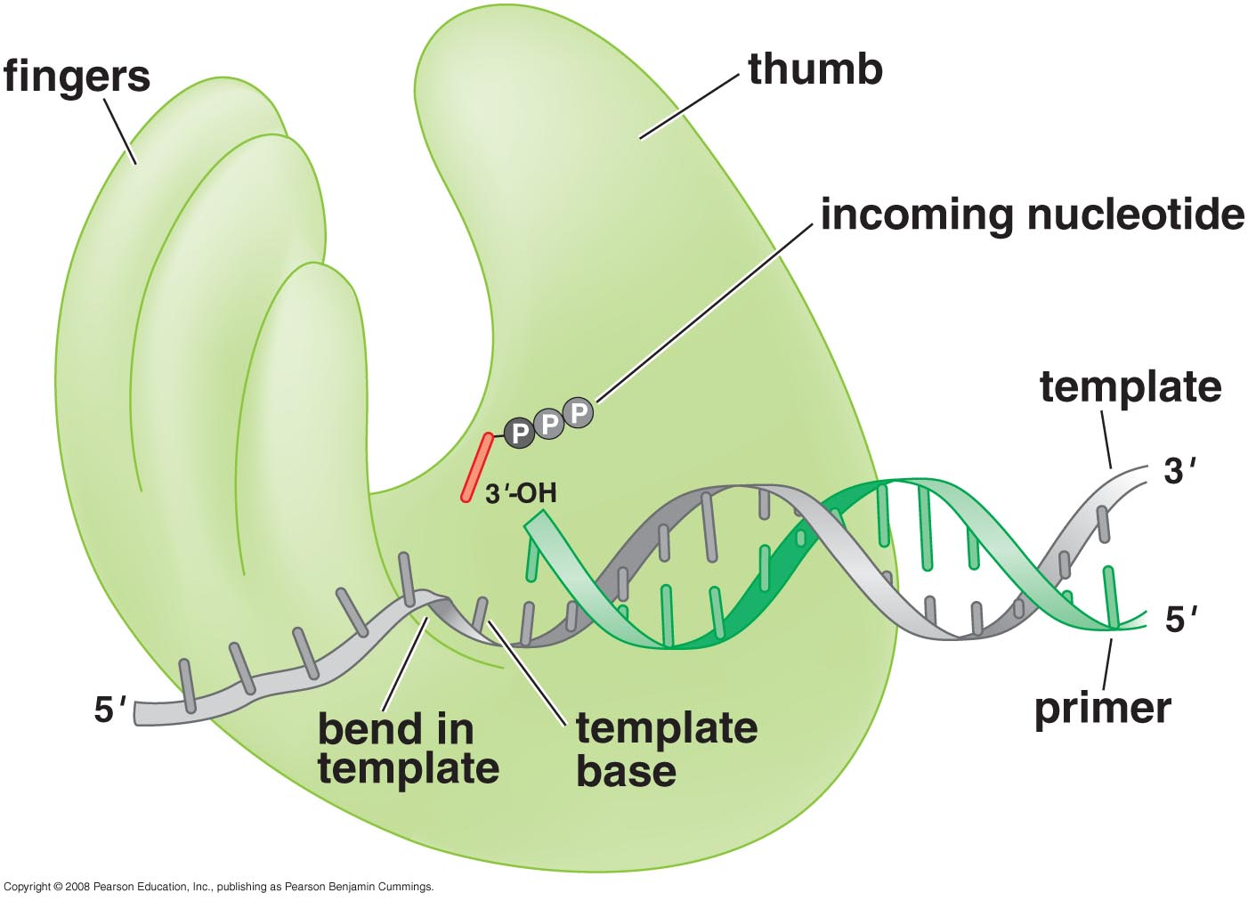

Slide 16
Thumb
The thumb domain is not involved in catalysis. In stead, it interacts with the DNA that has been most recently synthesized
This serves two purposes:
1- It maintains the correct position of the primer and the active site
2- It helps to maintain a strong association between the DNA polymerase and its substrate

Slide 17
Processivity
Fast; 1000 nucleotides /sec
Degree of processivity: average number of nucleotides added each time the enzyme binds a primer:template junction
Few to > 50,000
Rate increased dramatically by adding multiple nucleotides per binding event
It is the initial binding of polymerase to the primer:template junction that is rate-limiting for DNA synthesis (~ 1 sec)

Slide 18
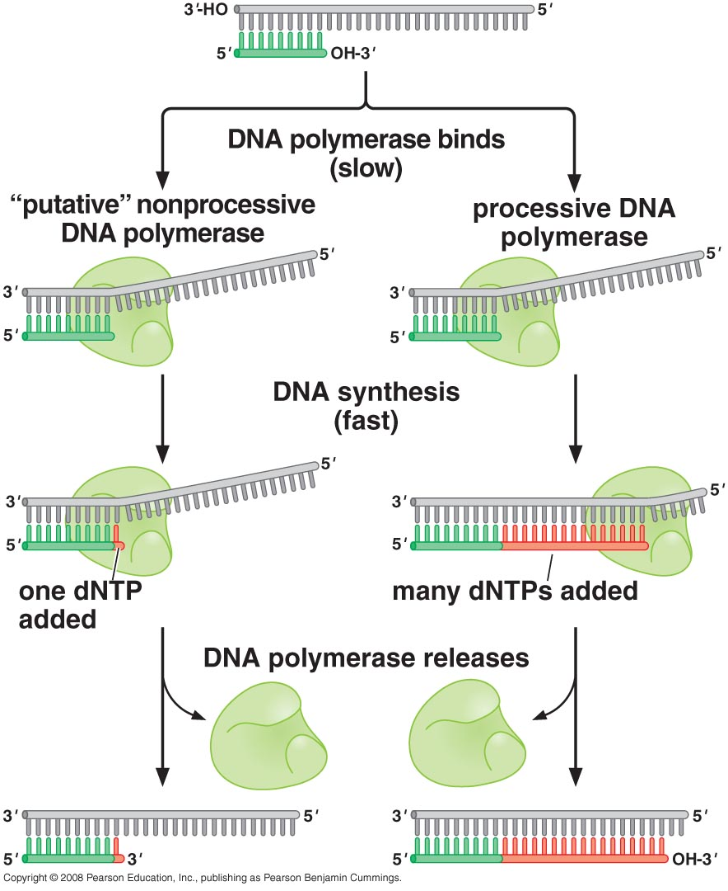
Notes:
Highly processive polymerase increases the overall rate of DNA synthesis by as much as 1000-fold compared to a completely nonprocessive enzyme
Increased processivity is facilitated by the ability of DNA polymerase to slide along the DNA template
Further increase in processivity is achieved through interactions between the DNA polymerase and a “sliding clamp” protein that completely encircles the DNA

Slide 19
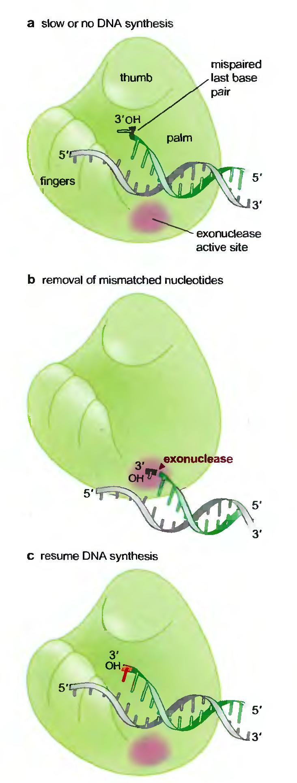
Proofreading exonuclease
Highly accurate (~ 1 mistake in every 10¹⁰ bp added)
Major limit: occasional (1 in 10⁵ times) flicking of the bases into the wrong tautmeric form.
Proofreading is mediated by nuclease that was originally identified in the same polypeptide as the DNA polymerase
Capable of degrading the DNA from the 3' end (incorrect base pairs)
Removal of the mismatched nucleotides is facilitated by the reduced ability of DNA polymerase to add a nucleotide adjacent to an incorrectly base-paired primer
Notes:
Mispaired DNA alters the geometry of the 3’OH and the incoming nucleotide because of poor interactions with the palm region
This altered geometry reduces the rate of nucleotide addition in much the same way that addition of incorrectly paired dNTP catalysis
When a mismatched nucleotide is added, it both decreases the rate of new nucleotides addition and increases the rate of proofreading exonuclease activity.

Slide 20
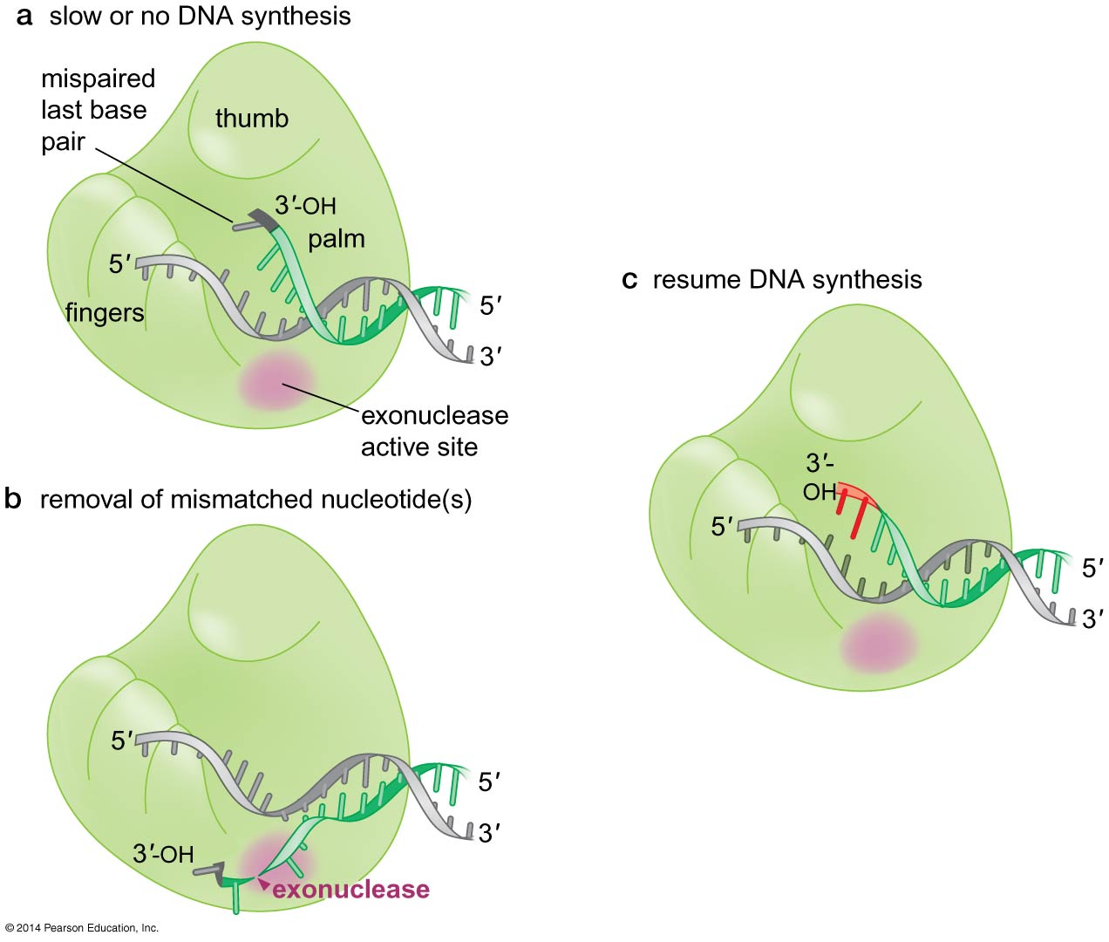
Figure 9-11
Notes:
20
Figure 9-11

Slide 21
How replication takes place inside the cell

Slide 22
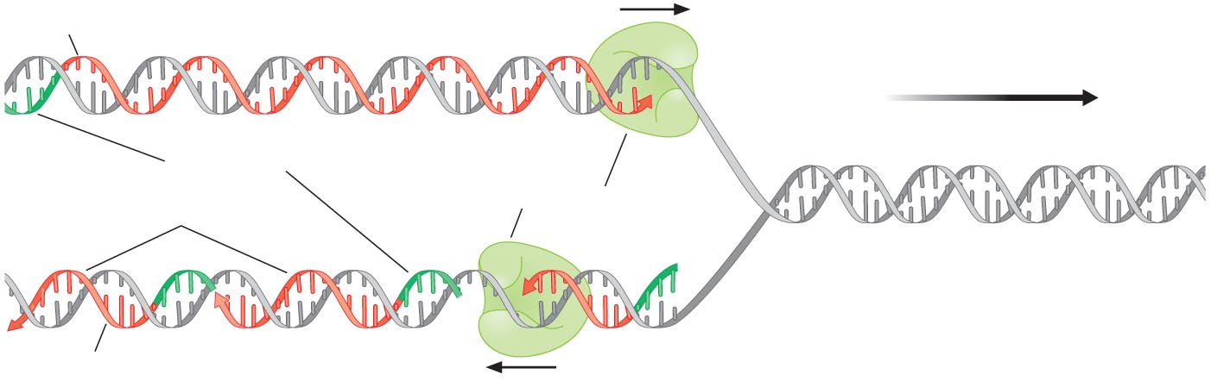
Replication fork
The junction between the newly synthesized template strands and the unreplicated duplex DNA
Leading strand
Lagging strand

Slide 23
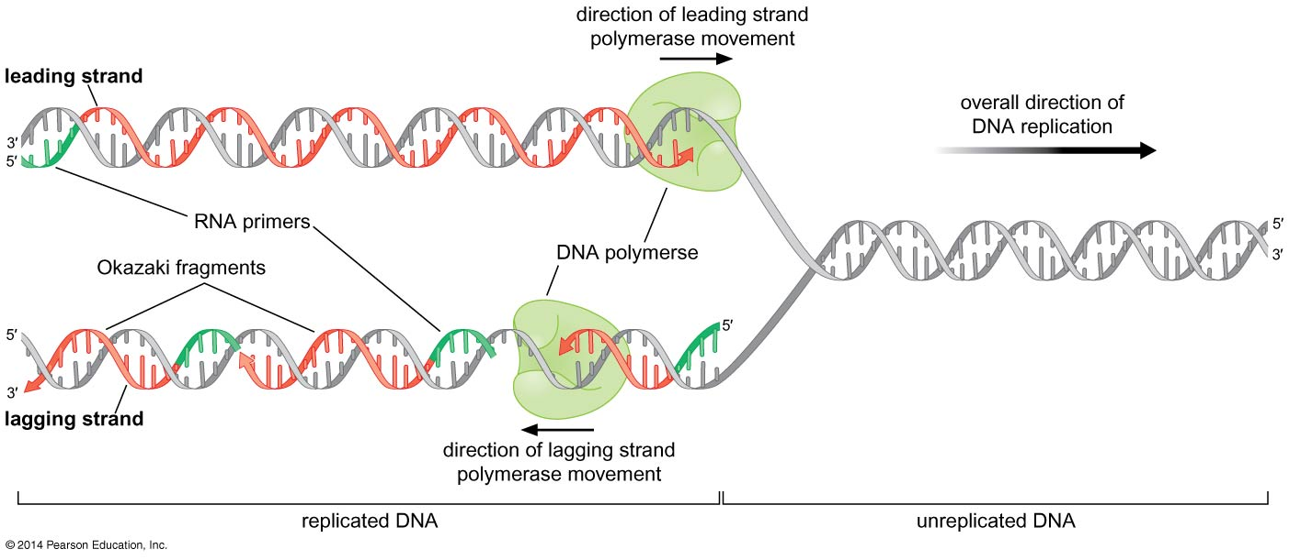
Figure 9-12
Notes:
23
Figure 9-12

Slide 24
RNA primer
Primase is a specialized RNA polymearse dedicated to making short RNA primers (5-10 nucleotides long) on an ssDNA template
It does not require an extensive DNA sequence to initiate synthesis of a new RNA primer e.g. GTA in case of E.coli
Primase activity increased when it associates with the DNA helicase which unwinds the DNA at the replication fork creating the ssDNA template

Slide 25
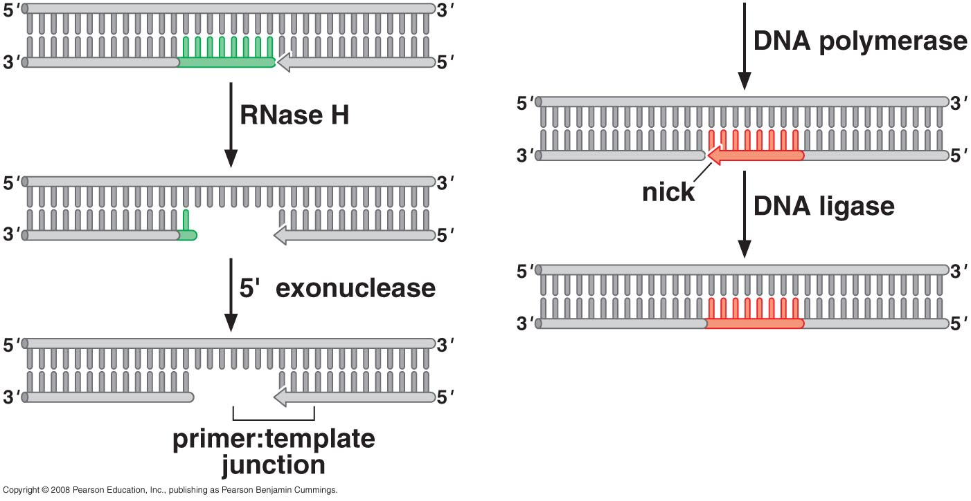
Removal of RNA primers by RNase H
Removes RNA paired with DNA (hybrid)
Breaks bond between ribonucleotides
Last rNTP removed by exonuclease
Filled by DNA polymerase
Filled gap by ligase
RNase H stands for Ribonuclease H.
RNase H is an enzyme that specifically degrades the RNA strand of an RNA-DNA hybrid. It is crucial in various biological processes, including:
DNA replication and repair: Removing RNA primers from Okazaki fragments allows for the proper synthesis of the lagging strand.
Reverse transcription: In retroviruses, RNase

Slide 26
What separates the two strands?
DNA Helicase enzyme
Helicase bind to and move directionally along ssDNA using the energy of ATP hydrolysis to displace any DNA strand that is annealed to the bound ssDNA
Usually hexameric protein with high processivity because they encircle one of the two strands at the replication form near the junction
There are specialized mechanisms that open the DNA helicase ring and place it around the DNA before reforming the ring
DNA helicase can have a polarity of either 5’→ 3’ or 3’ → 5’ defined according to the strand of DNA bound, rather than the strand that is displaced
Notes:
Uploaded by protein and leaves only when strand terminate
Polarity of 5`-3` or 5`-3` according to strand it encircle

Slide 27
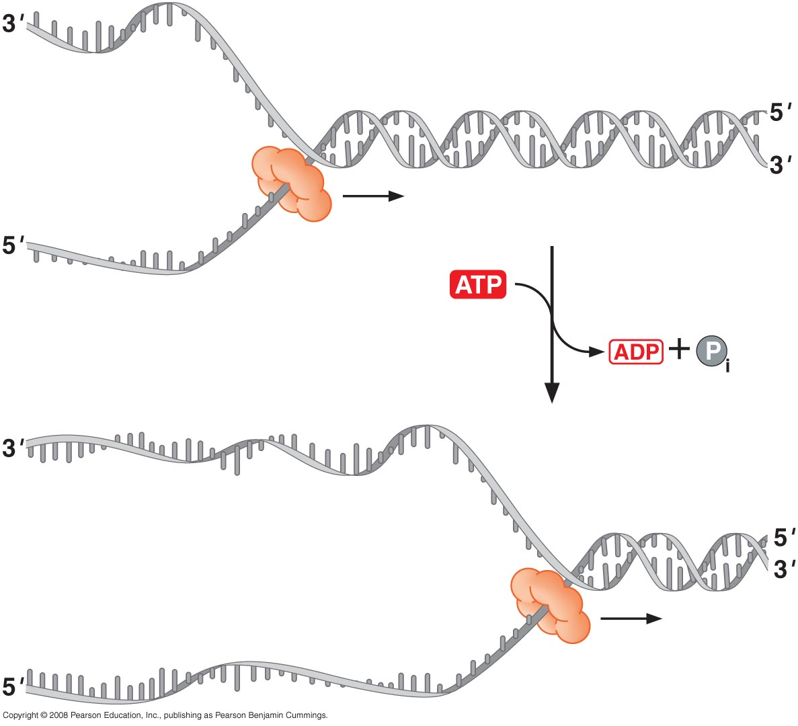
DNA helicase

Slide 28
Suggested mechanism of action
The ssDNA is encircled by the six subunits of the helicase.
Each subunit has a hairpin protein loop that binds a phosphate of the DNA backbone and its two adjacent ribose components
These DNA-binding loops are found in a right-handed spiral staircase, each binding the next phosphate along the ssDNA

Slide 29
A subunit first binds the ssDNA at the top of the structure and the DNA-binding loop moves through successive conformations, each is associated with a different nucleotide-bound state; the top is in an ATP-bound state, the middle is in an ADP-bound and the bottom lacks a bound nucleotide
As a single subunit binds, hydrolyzes and releases ATP, it will cycle through the top, middle and bottom conformations
In addition to translocating along ssDNA, a helicase must also displace the complementary strand to cause DNA unwinding

Slide 30
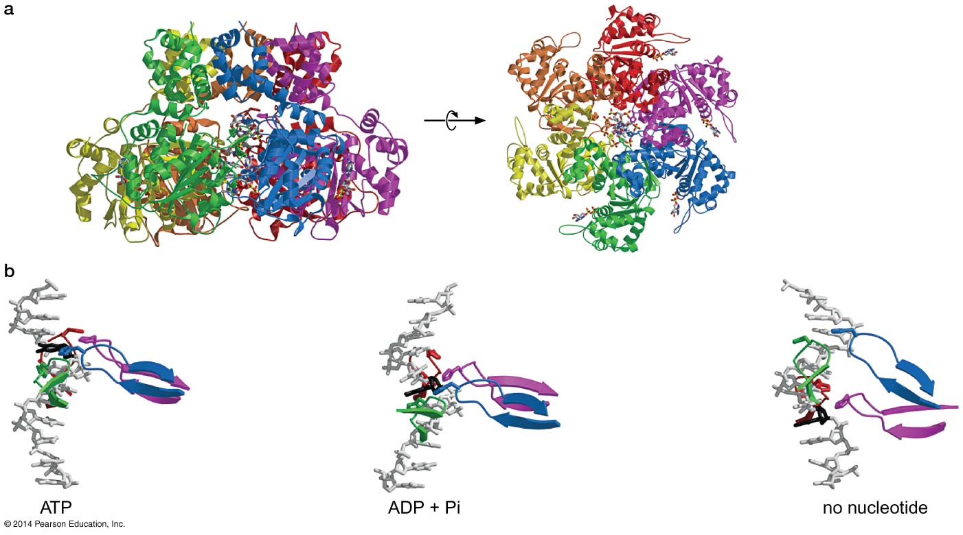
Structure and proposed mechanism of a DNA helicase
ATP-bound
ADP-bound
unbound

Slide 31
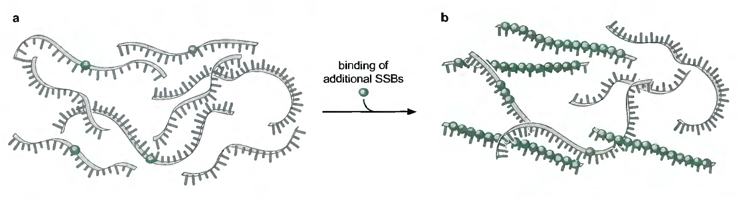
SSB proteins stabilizes ssDNA prior to replication
ssDNA-binding proteins rapidly bind to the separated strands
Binding of one SSB promotes the binding of another SSB (cooperative binding)
SSB interacts with ssDNA in a sequence-independent manner through electrostatic interactions with DNA bases

Slide 32
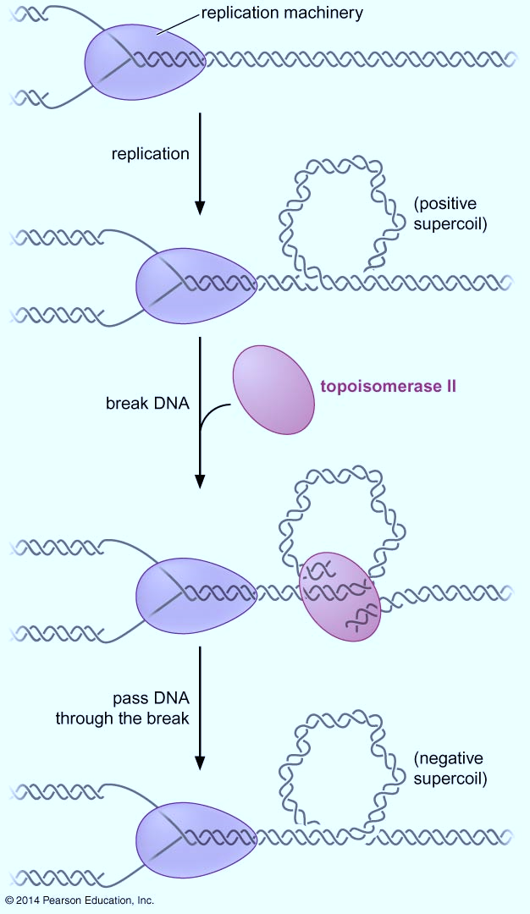
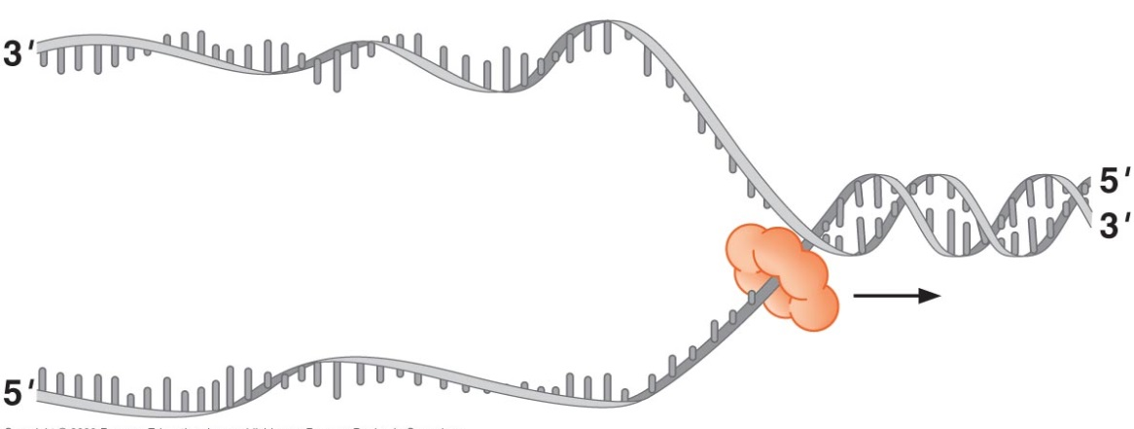
Problems of unwinding DNA
Helicase introduces positive supercoils which can
Be removed by Topoisomerases that act on unreplicated
dsDNA in front of the replication fork

Slide 33
Feature | Negative Supercoiling | Positive Supercoiling
Helical Twist | Left-handed, underwound | Right-handed, overwound
Effect on DNA | Loosens helix, easier to separate | Tightens helix, harder to separate
Role in Cells | Facilitates access for transcription and replication | Stabilizes DNA, common in thermophiles
Generated By | DNA gyrase (in prokaryotes) | Naturally occurs during replication, managed by topoisomerases

Slide 34
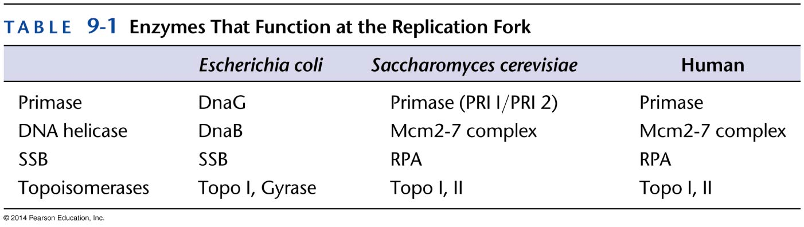
Replication fork enzymes extend the range of DNA polymerase substrates

Slide 35
The specialization of DNA polymerase

Slide 36
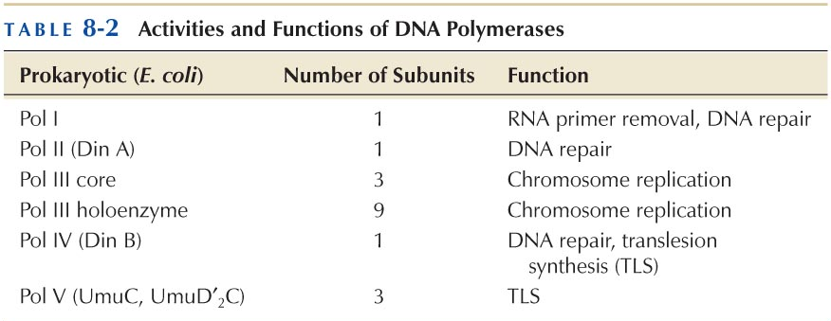
DNA Polymerases in Prokaryotes
Notes:
Pol I: it includes 5` exonuclease to remove RNA primer and replace it with DNA, can work with small DNA sequences only, so it is not highly processive,
Pol I is not highly processive, it adds 20-100 nucleotides per binding event which is ideal for primer removal and DN synthesis across the resulting ssDNA gap
ideal for replacing the short region previously occupied by the RNA primers
Pol III: responsible for DNA replication, highly processive so only 2 polymerases can replicate the whole bacterial genome
Only pol I and pol III have proofreading activity

Slide 37
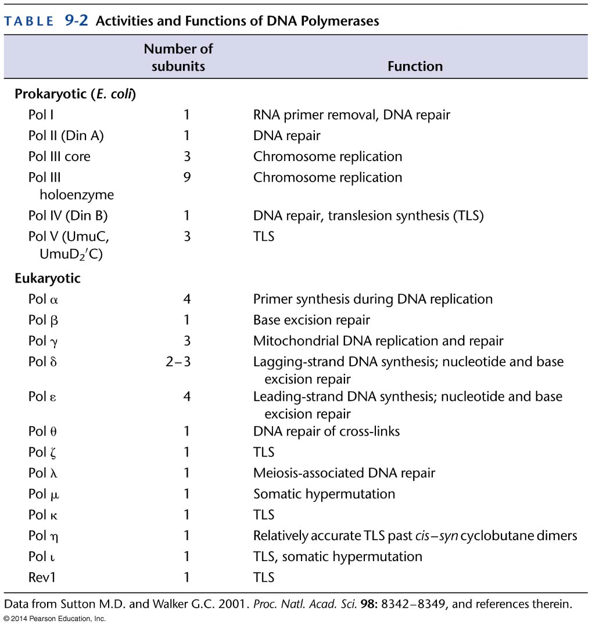
DNA Polymerases in Eukaryotes

Slide 38
Uppercase | Lowercase | Pronunciation | Common Uses in Science/Math
Α | α | Alpha | Angular acceleration, alpha particles
Β | β | Beta | Beta particles, coefficients, angles
Γ | γ | Gamma | Gamma rays, gamma function
Δ | δ | Delta | Change in quantity (Δ), small delta (δ) for partial derivatives
Ε | ε | Epsilon | Strain in materials, permittivity (ε)
Ζ | ζ | Zeta | Damping ratio, zeta function
Η | η | Eta | Efficiency in physics and engineering
Θ | θ | Theta | Angle in trigonometry, potential temperature
Ι | ι | Iota | Minor use; often just refers to a very small quantity
Κ | κ | Kappa | Curvature, dielectric constant (κ)
Λ | λ | Lambda | Wavelength, eigenvalues, decay constant
Μ | μ | Mu | Micro- (prefix), coefficient of friction, magnetic permeability
Ν | ν | Nu | Frequency, kinematic viscosity
Ξ | ξ | Xi | Random variables, eigenvalues
Ο | ο | Omicron | Rarely used in scientific contexts
Π | π | Pi | Mathematical constant π (~3.14159), product operator
Ρ | ρ | Rho | Density, correlation coefficient
Σ | σ | Sigma | Summation (Σ), standard deviation, stress
Τ | τ | Tau | Torque, time constant, shear stress
Υ | υ | Upsilon | Less common; sometimes for particle names
Φ | φ | Phi | Magnetic flux, angle in polar coordinates, Golden Ratio
Χ | χ | Chi | Chi-square in statistics, electric susceptibility
Ψ | ψ | Psi | Wave function in quantum mechanics
Ω | ω | Omega | Ohms (Ω), angular velocity, solid angle

Slide 39
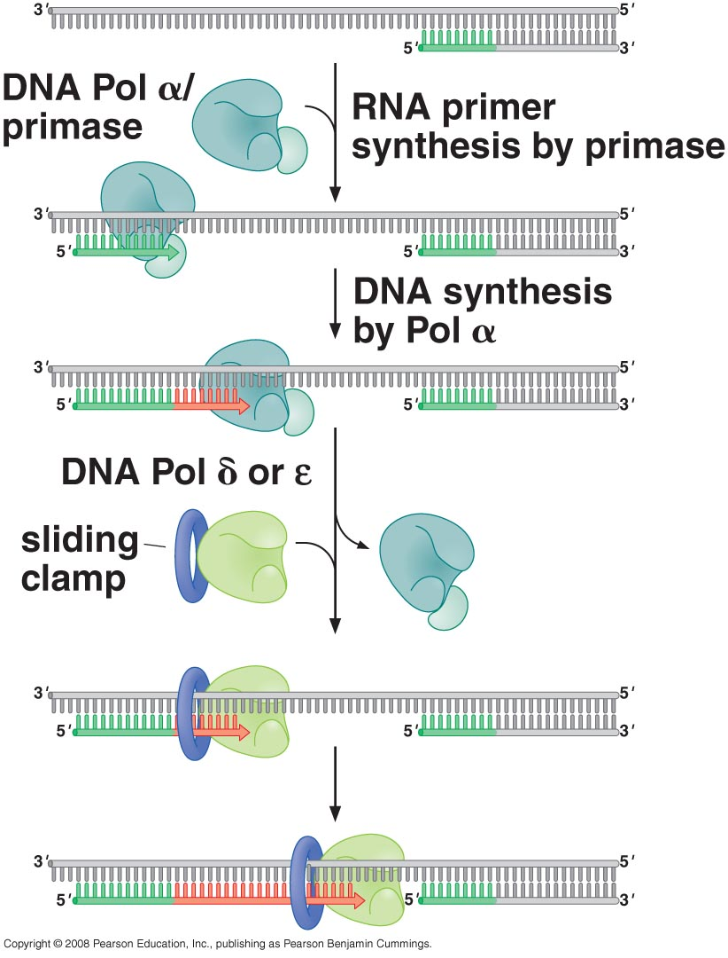
Polymerase switching
Notes:
δ polymerase goes to one strand & ε polymerase go to the other

Slide 40
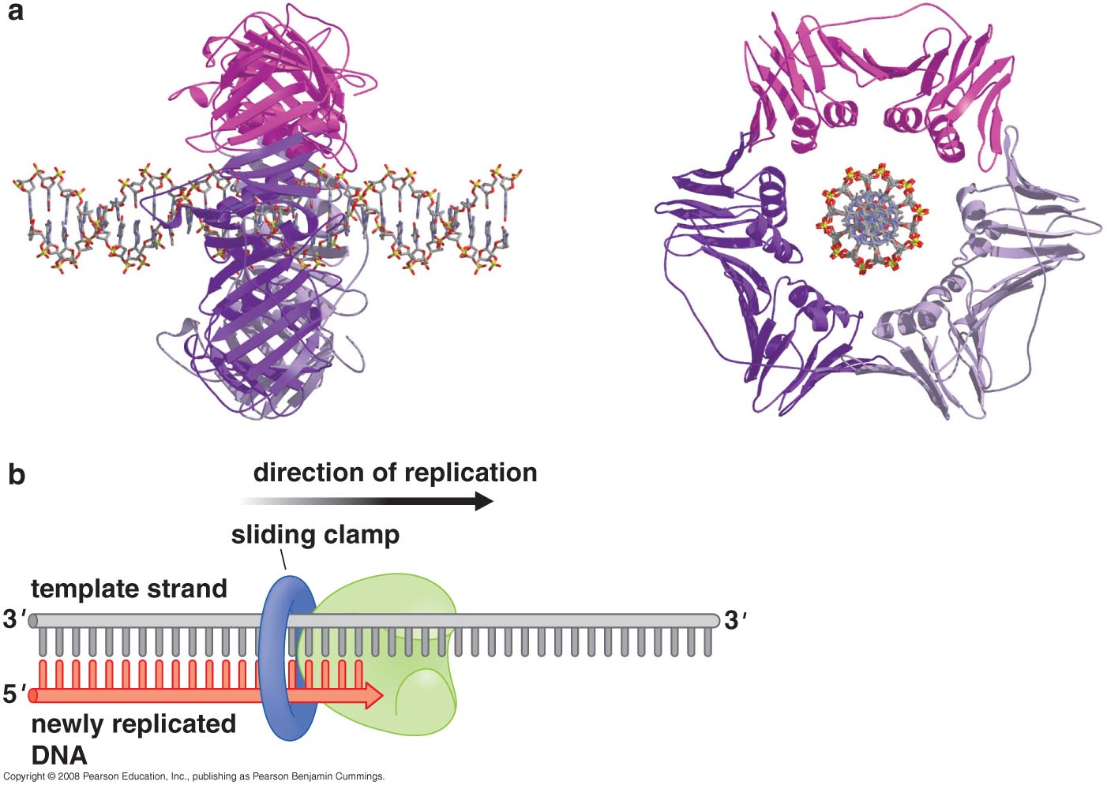
Structure of a sliding DNA clamp
Notes:
High processivity ensures rapid chromosome duplication
In the absence of other proteins, the DNA polymerases that cat at the replication fork are only able to synthesize 20-100 bp before releasing from the template
How is the processivity of these enzymes increased so dramatically at the replication fork?
Through association with proteins called sliding DNA clamps.
These are multiple identical subunits that assemble in the shape of a doughnut
The hole in the center of the clamp is large enough to encircle the DNA and leave room enough for one or 2 water molecules
The resulting complex between the polymerase and the clamp moves efficiently along the DNA template during synthesis
Sliding DNA clamps also bind tightly to DNA polymerase at the replication fork

Slide 41
How does the association with the sliding clamp change the processivity of DNA polymerase?
In the absence of sliding clamp, the DNA polymerase dissociates and diffuses away from the template DNA on average every 20-100 bp synthesized
In the presence of the sliding clamp, the DNA polymerase still disengages its active site from the 3’OH end of the DNA frequently, but the association with the sliding clamp prevents the polymerase from diffusing away from the DNA
By keeping the polymerase in close proximity to the DNA, the clamp ensures that the DNA polymerase rapidly rebinds the same primer:template junction, vastly increasing the processivity of the DNA polymerase
When a polymerase completes the replication of a stretch of DNA, it is released from the sliding clamp so it can act at a new primer:template junction
Notes:
Once released from a DNA polymerase, Sliding clamps are not immediately removed from the replicated DNA. Instead, other proteins that must function at the site of recent DNA synthesis to perform their function interact with the clamp proteins e.g. enzymes that assemble chromatin in eukaryotic cells are recruited to the sites of DNA replication by an interaction with the eukaryotic sliding DNA clamp(called PCNA)

Slide 42
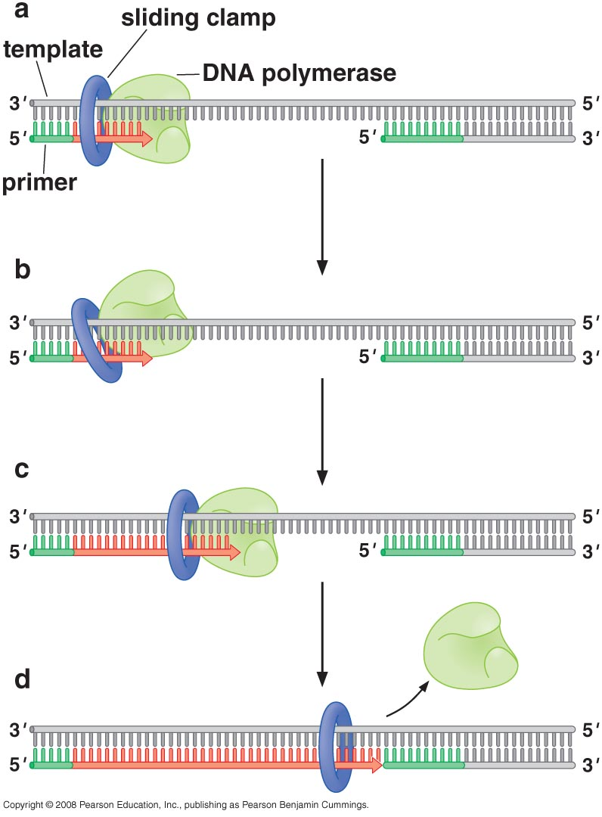
Sliding clamp increase DNA polymerase processivity
Notes:
Binding of DNA to DNA polymerase is the rate determining step in DNA replication so to keep the reaction very quick and make polymerases very processive DNA polymerase must stay with DNA this is achieved by sliding clamp to allow it to synthesize thousands – millions of DNA

Slide 43
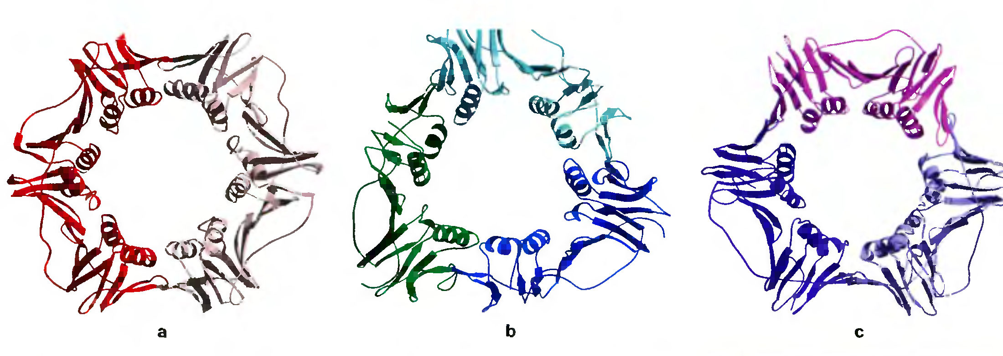
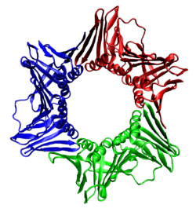
Sliding DNA clamps
E.coli
T4 phage
Euk. PCNA
Conserved structure among different species.
Conduct same function.
PCNA: Proliferating cell nuclear antigen (PCNA) which is a DNA clamp that acts as a processivity factor for DNA polymerase in eukaryotic cells and is essential for replication.

Slide 44
How can the clamp encircle DNA?
It must open up
Achieved by sliding clamp loader
These enzymes couple ATP binding and hydrolysis to the placement of the sliding clamp around primer:template junctions of the DNA
The clamp loader also removes sliding clamps from DNA when they are no longer in use
Notes:
Formation of the tertiary complex of sliding clamp, primer template junction and sliding clamp loader with ATP will trigger ATP hydrolysis which in turn will dissociate the loader
The sliding clamp should be free from any interacting proteins
DNA polymerase
Nucleosome assembly proteins
Chaperons
Histone remodeling complexes
Okazaki fragment repair proteins
DNA repair protein

Slide 45
The sliding clamp loader is a protein complex involved in DNA replication, responsible for loading the sliding clamp onto DNA. The sliding clamp (such as PCNA in eukaryotes or the β-clamp in prokaryotes) is a ring-shaped protein encircles DNA and holds the DNA polymerase in place, ensuring high processivity during replication.
How the Sliding Clamp Loader Works:
Recognition and Binding: The sliding clamp loader recognizes the primer-template junction on the DNA where replication begins.
ATP Binding: The clamp loader binds ATP, which induces a conformational change that opens the sliding clamp ring.
Clamp Loading: The opened sliding clamp is loaded onto the DNA at the primer-template junction.
Clamp Closure and Release: Once the clamp is properly positioned, ATP is hydrolyzed, closing the sliding clamp around the DNA and releasing the clamp loader.
Importance in DNA Replication:
Processivity: The sliding clamp holds DNA polymerase onto the DNA strand, allowing it to synthesize long stretches of DNA without falling off.
Coordination: The clamp loader is critical in coordinating replication on both the leading and lagging strands, particularly in loading new clamps for Okazaki fragment synthesis on the lagging strand.
In summary, the sliding clamp loader is essential for efficient and accurate DNA replication, making sure that DNA polymerase can replicate large sections of DNA continuously and with minimal errors.

Slide 46
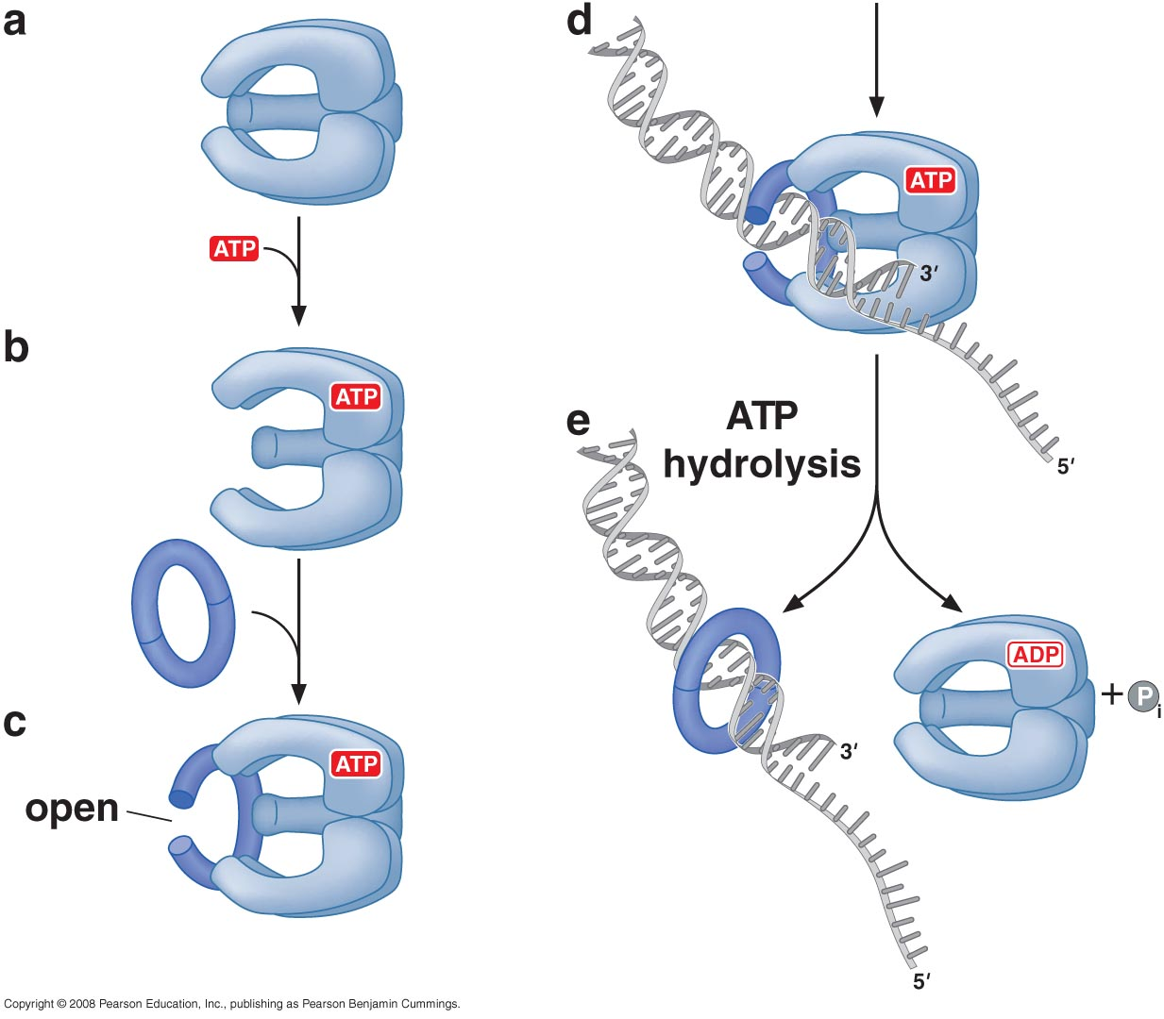

Slide 47
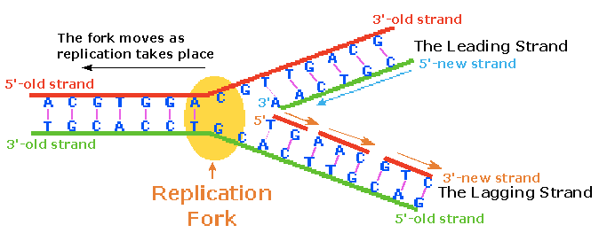
DNA synthesis at replication fork
Quick DNA synthesis is important to reduce risk of ssDNA breakage.

Slide 48
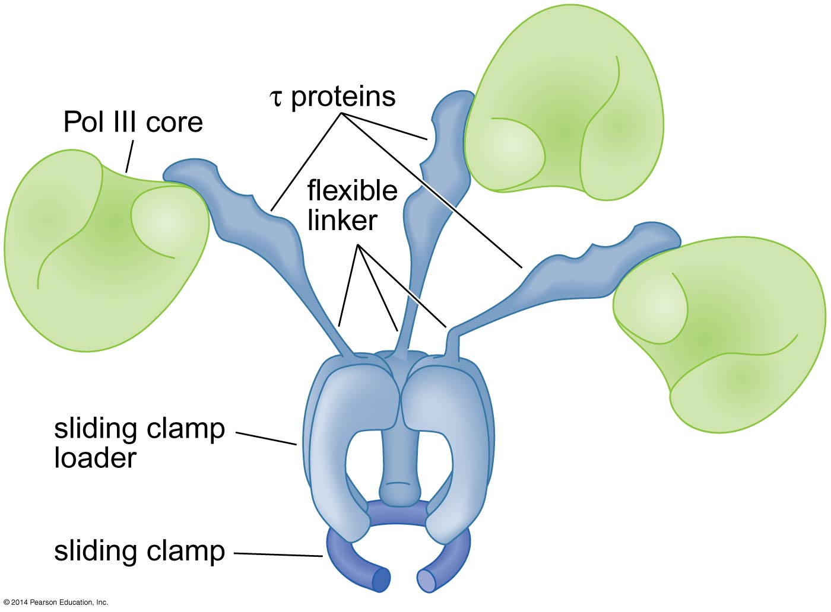
DNA Synthesis at replication fork in Prokaryotes
To coordinate the replication of both DNA strands, multiple DNA polymerases function at the replication fork
Holoenzyme link the Three polymerases
In E.coli, the coordinate action of these polymerases is facilitated by physically linking them together in a large multiprotein complex called DNA Pol III holoenzyme
Holoenzyme is a general name for multiprotein complex in which the core enzyme activity is associated with additional components that enhance function
Notes:
In E.coli, the coordinate action of these polymerases is facilitated by physically linking them together in a large multiprotein complex called DNA Pol III holoenzyme
Holoenzyme is a general name for multiprotein complex in which the core enzyme activity is associated with additional components that enhance function

Slide 49
How do two DNA polymerases remain linked at the replication fork while synthesizing DNA on both the leading and lagging template strands?

Slide 50
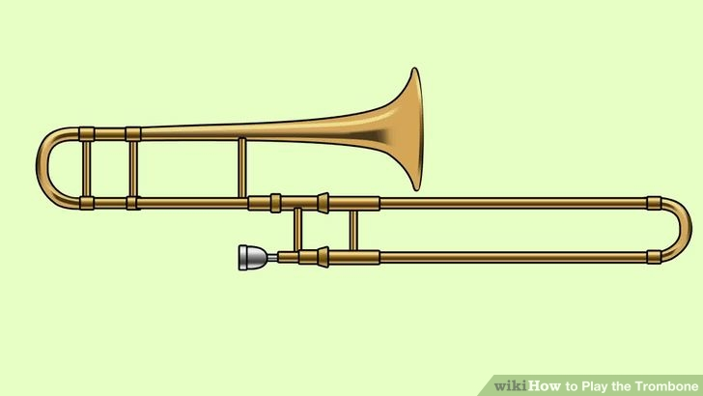
Trombone model for coordinating replication by two polymerases at the E.coli replication fork
Notes:
Changing size of the ssDNA loop formed between the DNA polymerase and the DNA helicase on the lagging-strand template

Slide 51
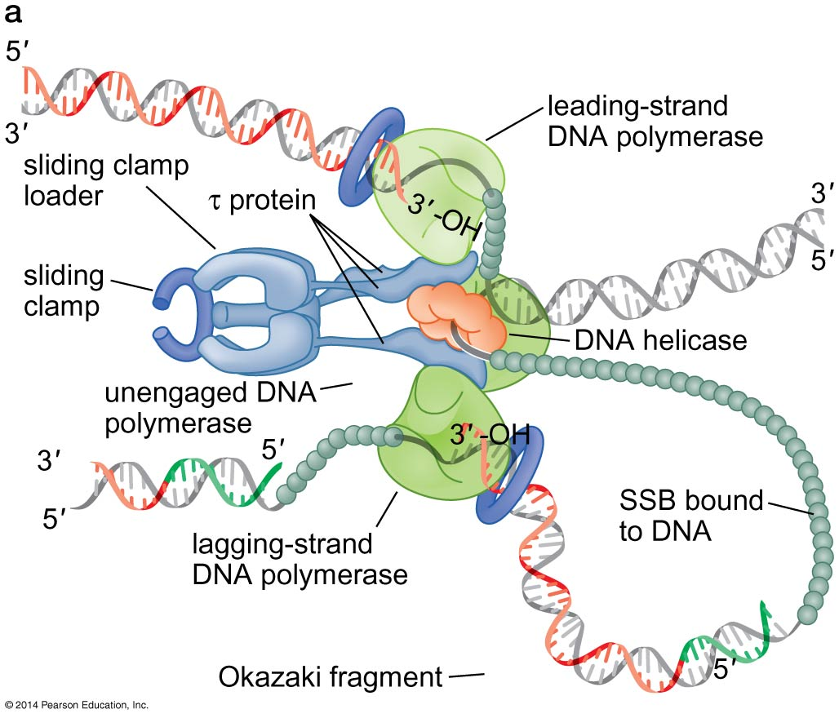
The helicase travels on the lagging strand template in a 5’→3’ direction.
The DNA Pol III holoenzyme interacts with DNA helicase through the tau-subunit, which also binds to both polymerases
One Pol III core is replicating the leading strand and the other core replicates the lagging strand
SSB coats the ssDNA regions of the DNA
Notes:
As the helicase unwinds the DNA at the replication fork, the leading strand template is exposed and acted on immediately by the leading strand DNA polymerase, which synthesizes a continuous strand of complementary DNA.
In contrast, the lagging strand template is not immediately acted on by DNA polymerase. Instead, it is spooled out as ssDNA that is rapidly bound by SSB.
Intermittently, primase interacts with the helicase and is activated to synthesize a new RNA primer on the lagging strand template.

Slide 52
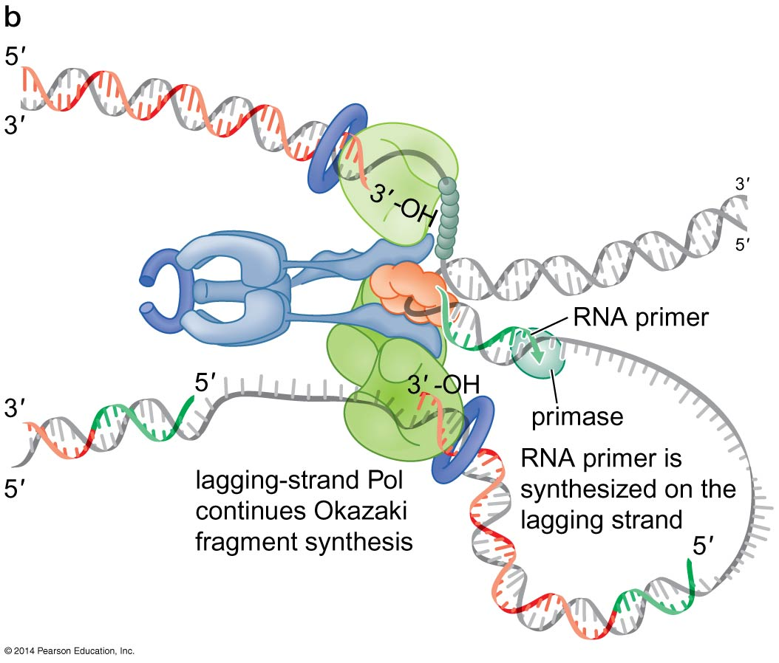
Periodically, DNA primase will associate with the DNA helicase and synthesize a new primer on the lagging-strand template

Slide 53
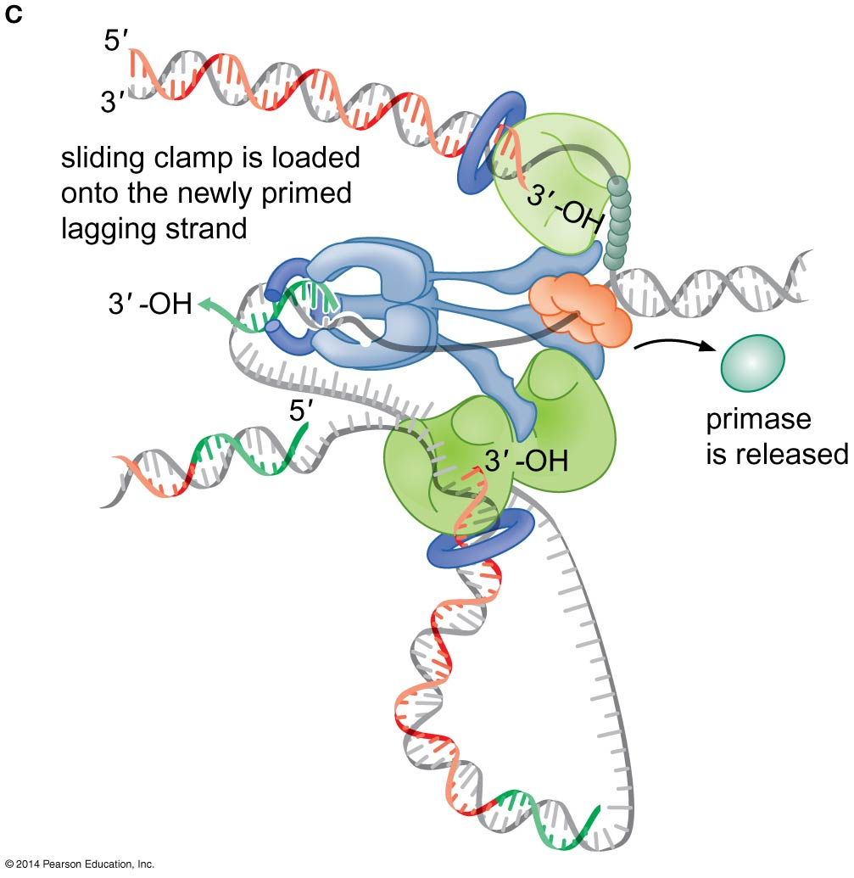
When the lagging-strand DNA polymerase completes an Okazaki fragment, it is released from the sliding clamp and the DNA

Slide 54
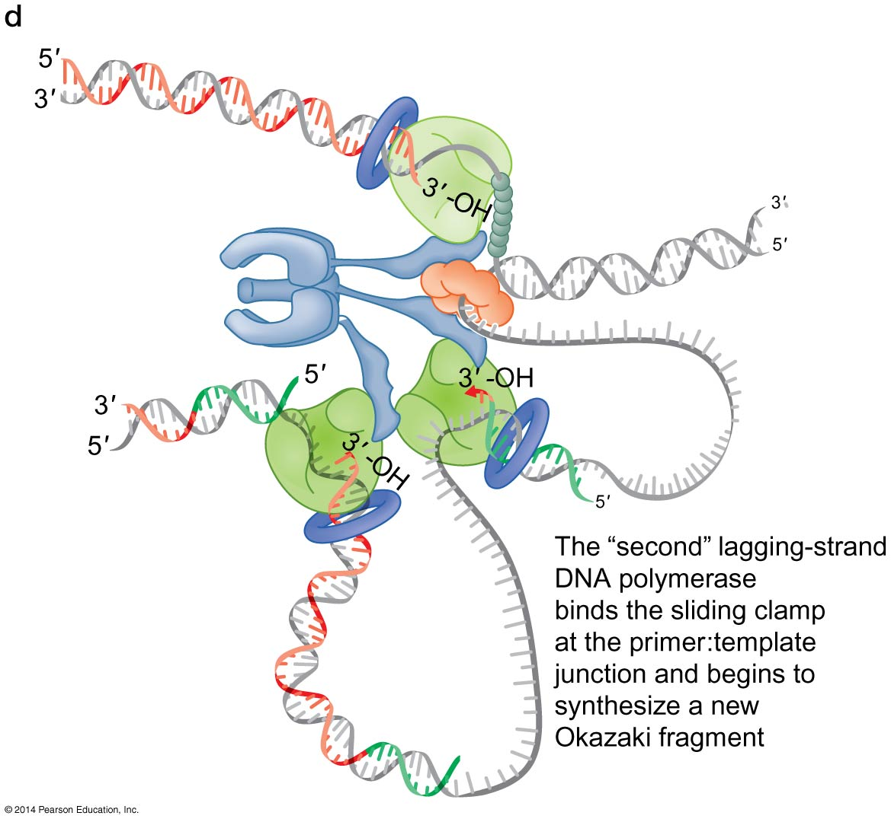
The recently primed lagging-strand DNA is then a target of the clamp loader, which assembles a new sliding clamp at the primer:template junction created by synthesizing a new RNA primer

Slide 55
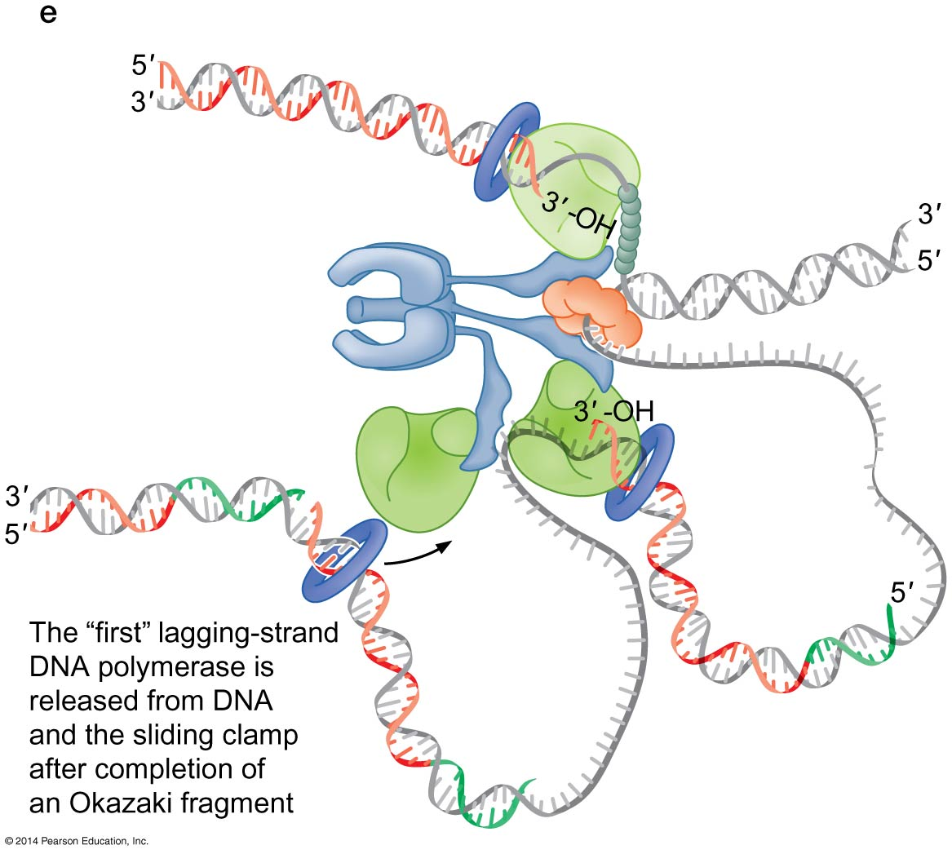
The primer: template junction with its associated sliding clamp binds to the lagging strand DNA polymerase, which initiates DNA synthesis on the next Okazaki fragment

Slide 56
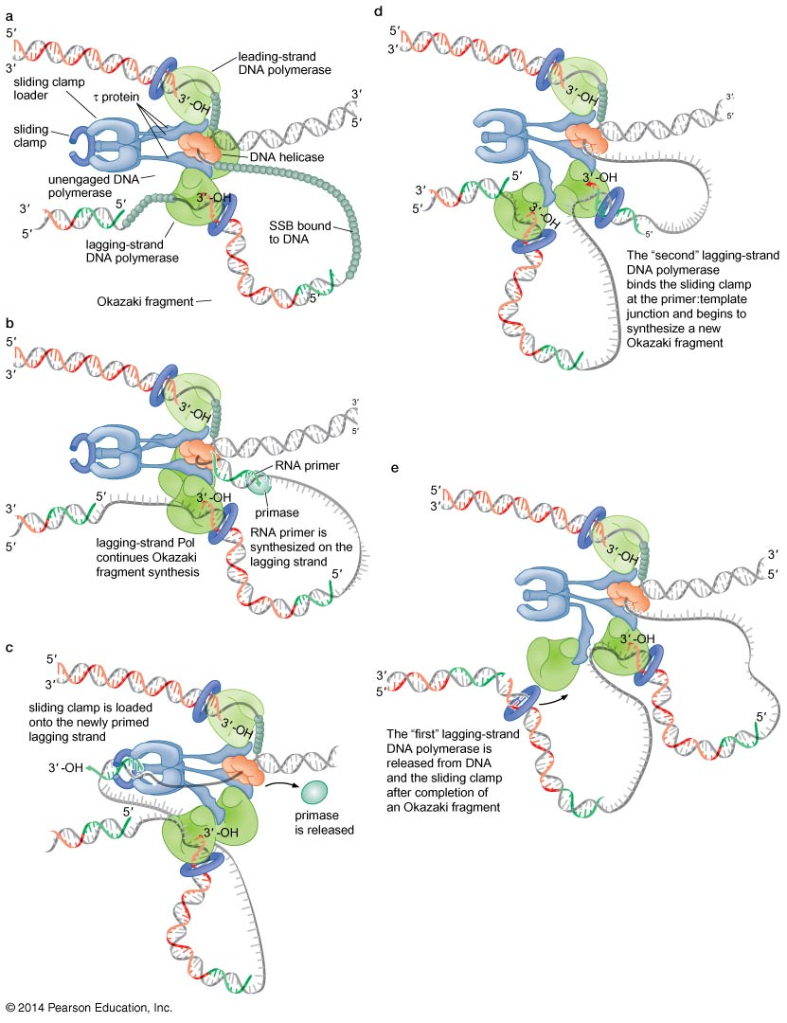
Figure 9-23
Notes:
56
Figure 9-23

Slide 57
Interactions between replication fork proteins from the E.coli replisome
DNA helicase and DNA Pol III holoenzyme
Mediated by the tau-subunit of the clamp loader component
This association stimulates the activity of the helicase by increasing the helicase movement by 10-fold
DNA helicase and the primase, weak but stimulated the primase activity by ~ 1000 fold
The primase is released after the primer is synthesized
The combination of all the proteins that function at the replication fork is called replisome

Slide 58
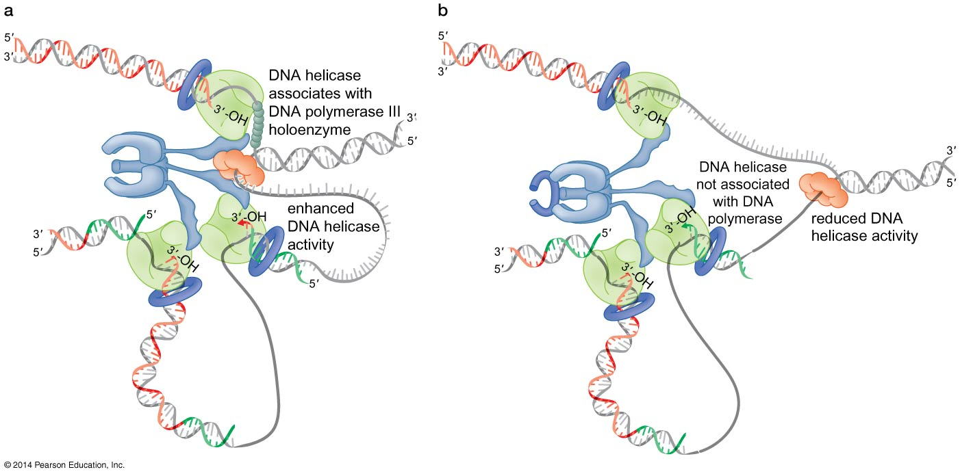
Binding of the DNA helicase to DNA Pol III holoenzyme stimulates the rate of DNA strand separation
Notes:
When tau interacts with both helicase and polymerase, the helicase unwinds the DNA at approximately the same rate as the DNA polymerase replicates the DNA
If te hhelicase is not associated with Pol III , DNA unwinding slows by 10 fold

Slide 59
Initiation of Replication
Origins of replication: specific sites at which DNA unwinding and initiation of replication occur

Slide 60
Replicon Model of replication initiation
Model proposed by Jacob, Brenner and Cuzin in1963.
A replicon: all DNA replicated from one origin of replication
E.coli: one replicon
Eukaryotes : several replicons

Slide 61
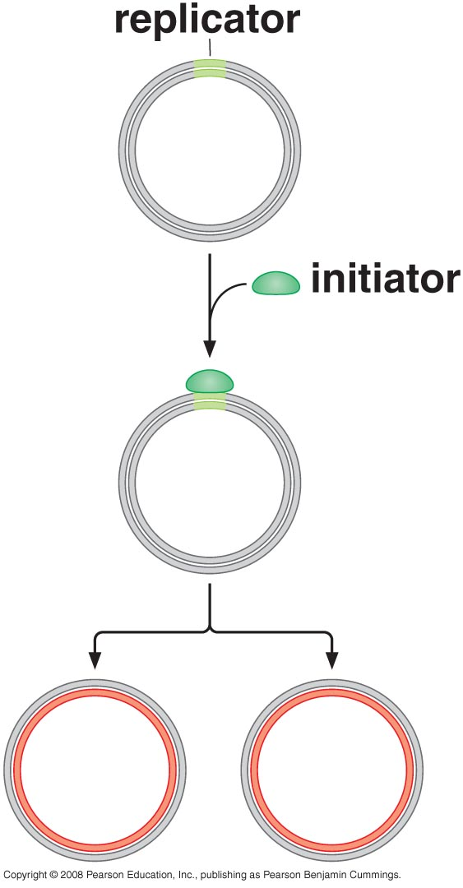
Replicon Model
Proposed that two components are needed:
Replicator: entire set of cis-acting DNA sequences that is sufficient to direct the initiation of replication (ori is part of the replicator)
Initiator: a protein that specifically recognizes a DNA element in the replicator and activates the initiation of replication.
All known initiator proteins are regulated by ATP binding and hydrolysis
Initiator proteins select the sites that will become origins of replication although they recognize DNA using different DNA-binding motifs

Slide 62
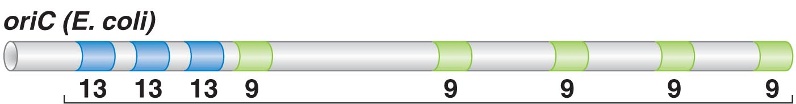
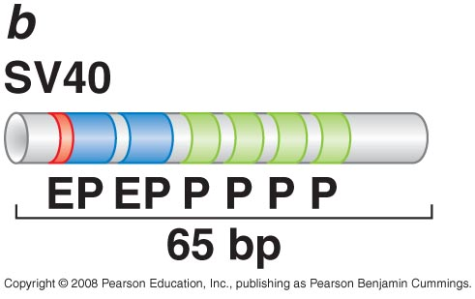
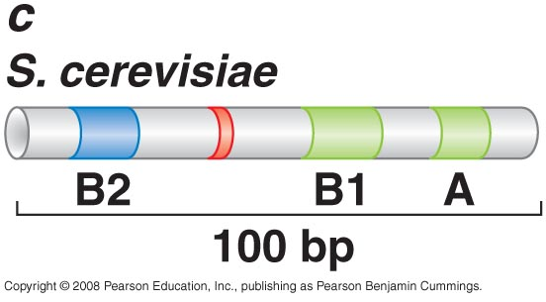
Replicator
Replicators share two features:
A binding site for the initiator protein that nucleates the assembly of the replication initiation machinery
A stretch of AT-rich DNA that unwinds readily but not spontaneously
Replicators functioning in multicellular eukaryotes are not well understood
3 13-mer AT rich sequence
5 9-mer initiator (DnaA) binding site
245 bp

Slide 63
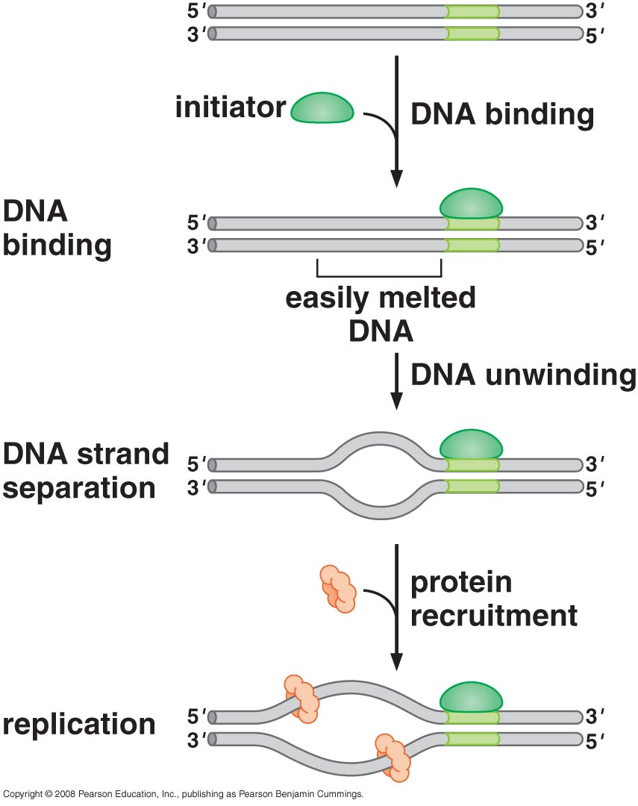
Initiator
Bind a specific DNA sequence within the replicator
Interact with additional factors required for replication initiation
Some but all distort or unwind a region of DNA adjacent to their binding site to facilitate the initial opening of the DNA duplex
In eukaryotes, the initiator is 6-protein complex called origin recognition complex (ORC).
It recognizes a conserved A element as well as less conserved B1 element
Notes:
DnaA binds the repeated 9-mer elements in oriC and is regulated by ATP. It also interacts with DNA in the region of the repeated 13-mer repeats of oriC
These additional interactions result in the separation of the DNA strands over >20 bp within the 13-mer repeat region. This ssDNA provides a template for other proteins
to begin the RNA and DNA synthesis steps of replication
However, the formation of ssDNA is NOT sufficient for the DNA helicase and other proteins to assemble. DnaA recruits other proteins to the ssDNA including the helicase
Like DnaA, ORC binds and hydrolyze ATP (required for sequence-specific DNA binding at the origin and loading of DNA helicase onto the replicator
Unlike DnaA, ORC does not lead to strand separation of the adjacent DNA.
It is required to recruit all of the remaining replication proteins to the replicator

Slide 64
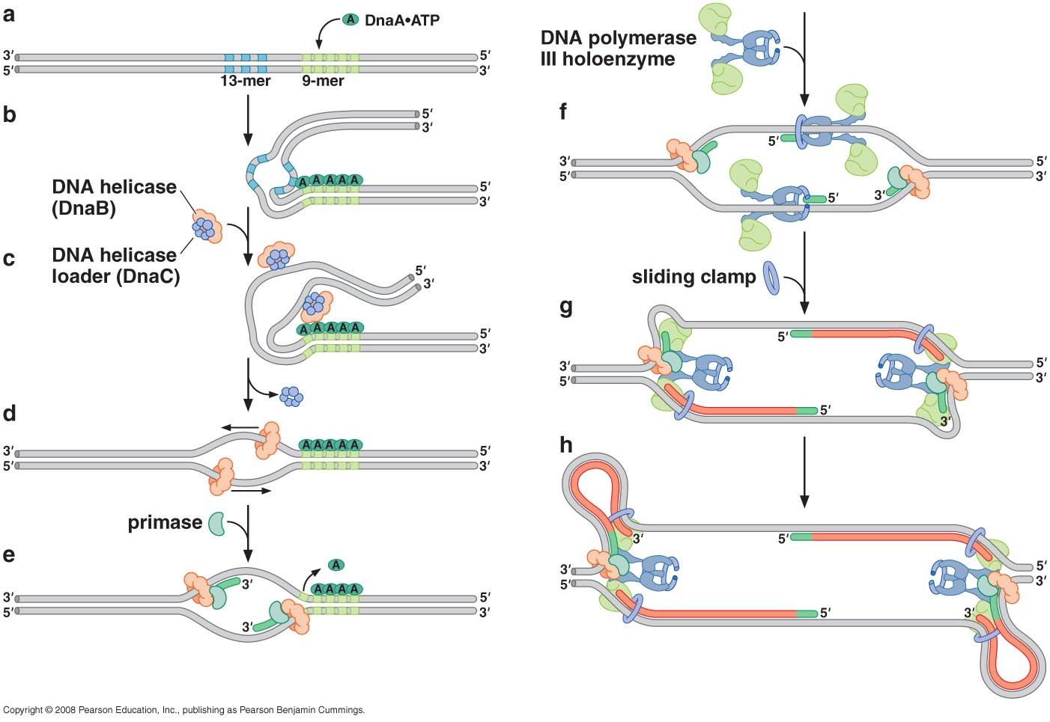
Model for Initiation of Replication in E.coli
Multiple DnaA.ATP proteins bind to the repeated 9-mer sequences within oriC
Binding of DnaA.ATP to these sequences leads to strand separation within the 13-mer repeats
DNA helicase (DnaB) and the DNA helicase loader (DnaC) associate with the DnaA-bound origin
Helicase loader catalyze the opening of the helicase ring and placement of the ring around the ssDNA at origin. Loading of the helicase leads to the dissociation of the helicase loader from the replicator and activates the helicase
The helicase recruits the primase which synthesize primer on each template. The movement of the helicase will also removes any remaining DnaA bound to the replicator
Notes:
Helicase loader load helicase using ATP hydrolysis, it opens helicase, then helicase loader.ADP which will be released from helicase and leave helicase behind
Helicase move in 5` to 3` direction, so each helicase will move in the opposite direction

Slide 65
Newly synthesized primers are recognized by the clamp loader components of three DNA Pol III holoenzymes.
Sliding clamps are assembled at each primer and leading strand synthesis is initiated by one of the three core Pol III holoenzymes
After each helicase has moved ~ 1000 bases, a second RNA primer is synthesized on each lagging strand template and a sliding clamp is loaded.
The resulting primer:template junction is recognized by the second Pol III core enzyme in each holoenzyme resulting in the initiation of lagging strand synthesis
Leading and lagging strand synthesis are now initiated at each replication fork and continue to the end of the template or until another replication fork from an adjacent origin or replication is reached
Notes:
Helicase is inactive when bound to helicase loader to prevent inappropriate unwinding of DNA, only activated when bound to DNA and become more active when it contact primase

Slide 66
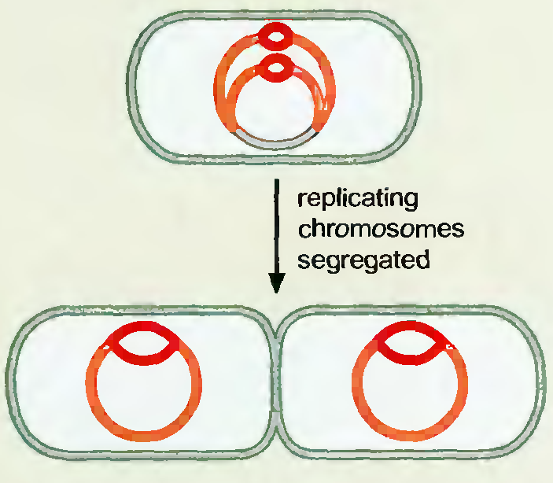
Replication Control
Prokaryotes need to replicate quickly
Prokaryotes allow reinitiation of replication before the cell divide to save time

Slide 67
Replication in Eukaryotes
Not well understood as in E.coli
3 polymerases involved in replication (α, ε, & δ polymerases)
Similar proteins are involved in replication but with different names
Many replicons are present (100s- 1000s)
Origin of replication ~30 kb apart

Slide 68
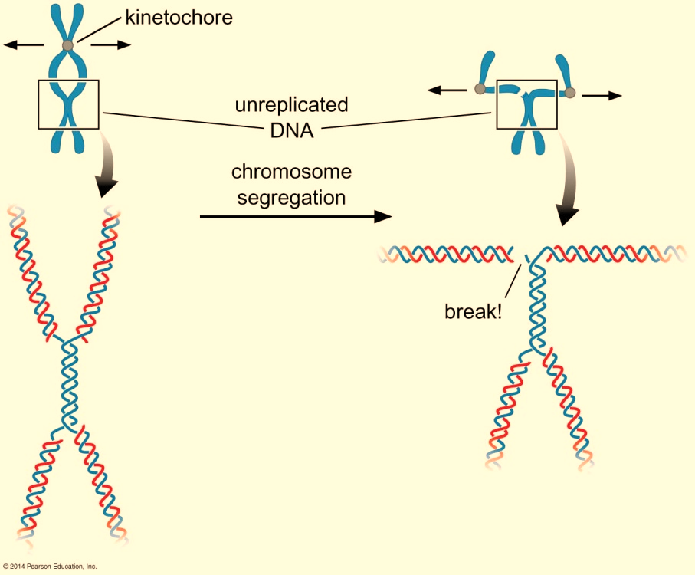
Eukaryotic chromosomes are replicated exactly once per cell cycle
Eukaryotic cell should replicate only once in one cell cycle (S phase)
More than one replication →multiple copies of sequences /chromosomes
No replication in one area → chromosome breakage
Segregation of linked chromosomes causes chromosome breakage or loss

Slide 69
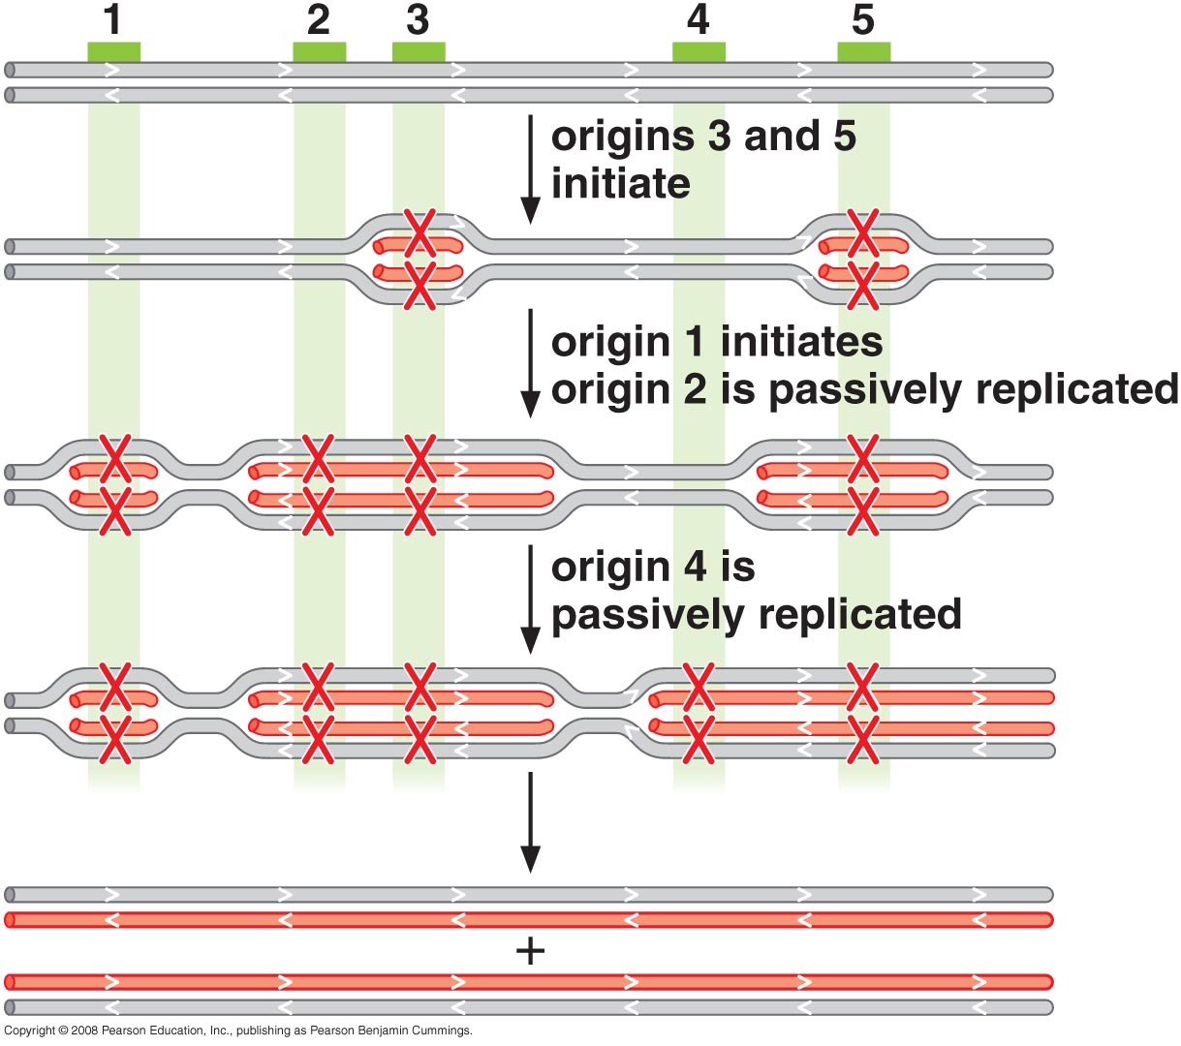
Replication Control
Whether an origin is activated to cause its own replication is replicated by a replication fork derived from an adjacent origin, it must be inactivated until the next round of cell division in cells with high turnover and quick replication a large number of origins of replication are activated to fasten the replication during S phase, if there is low turn over, fewer origins are activated. Some origins will never be activated.
Notes:
Whether an origin is activated to cause its own replication is replicated by a replication fork derived fro man adjacent origin, it must be inactivated until the next round of cell divisionIn cells with high turn over and quick replication a large number of origins of replication are activated to fasten the replication during S phase, if there is low turn over , fewer origins are activated . Some origins will never be activated.

Slide 70
Prereplicative complex formation is the first step in the initiation of replication in eukaryotes
Unlike prokaryotes, replication here involves two separate processes:
Replicator selection stage: the process of identifying sequences that will direct the initiation of replication and occurs in G1
Origin activation stage: only occurs after cells enter the S phase and trigger the replicator-associated protein complex to initiate DNA unwinding and DNA polymerase recruitment
Each step is distinct and takes place at a different stage in the cell cycle
These two steps are united in the prokaryotes, binding of the initiator with the replicator in prokaryotes is enough to initiate replication and recruit helicase
Select sites for DNA replication (among different origins of replication)
To ensure that each chromosome is replicated only once
Notes:
Each step is distinct and takes place at different stage in the cell cycle
These two steps are united in the prokaryotes, binding of initiator with the replicator in prokaryotes is enough to initiate replication and recruit helicase
Select sites for DNA replication (among different origins of replication)
To ensure that each chromosome is replicated only once

Slide 71
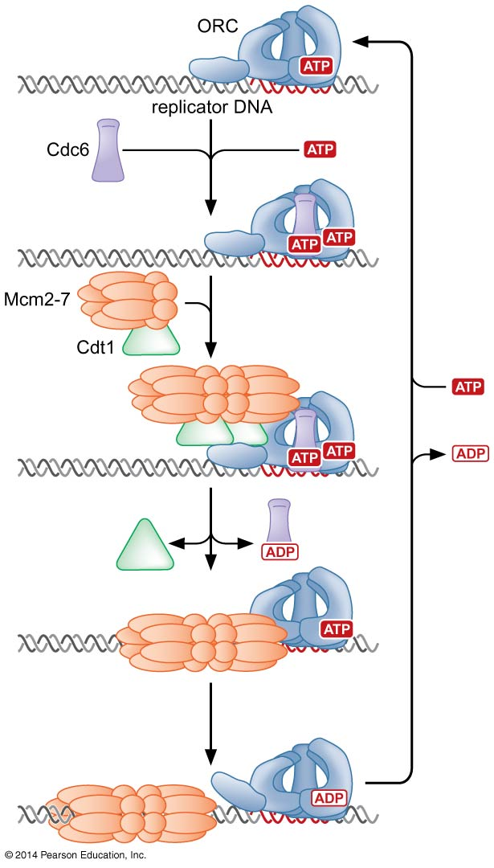
Replicator selection (G1 phase)
The assembly of the pre-RC is an ordered process that is initiated by the association of the origin recognition complex with the replicator
Once bound to the replicator, ORC recruits at leas two additional proteins , cdc6 and Cdt1 (helicase loading proteins)
These 3 proteins function together to assemble the eukaryotic DNA helicase –the Mcm2-7 complex at the replication and the formation of the pre-RC
Notes:
Each step is distinct and takes place at different stage in the cell cycle
These two steps are united in the prokaryotes, binding of initiator with the replicator in prokaryotes is enough to initiate replication and recruit helicase
Select sites for DNA replication (among different origins of replication)

Slide 72
Origin activation (S phase)
Pre-RCs that are formed during G1 are only activated to unwind DNA and initiate replication after cells pass from the G1 to the S phase of the cell cycle
Cdk (cyclin-dependent kinase) and DdK (Dbf4-dependent kinase) are the key regulators
Activate pre-RC
Inhibit formation of new pre-RC
Notes:
High level of protein kinases (Cdk and Ddk)
↓
Phosphorelation of pre-RC
Recruit other proteins (Polymerases and start with delta and epsilon first to make sure that they are available before recruiting alpha that initiate primer synthesis)
Helicase loaders (Cdc6 and Cdt1) are released

Slide 73

Activation of the pre-RC leads to the assembly of the eukaryotic replication
As cells enter into the S phase, Cdk and DdK phosphorylates Cdc6 and Cdt1 and trigger the initiation of replication → release of Cdc6 and Cdt1
The events that lead to unwinding of DNA are poorly understood but likely to require the activity of the Mcm complex and result in the recruitment of a number of auxiliary replication factors and DNA Pol δ and Pol ε
Once present at the origin, DNA Pol α /primase synthesizes an RNA primer and briefly extend it
Notes:
DNA Pol α /primase is only recruited after Pol δ and Pol ε.

Slide 74

The resulting primer: template junction is recognized by the eukaryotic sliding clamp loader (RF-C) which assembles a sliding clamp (PCNA) at these sites
DNA Pol ε recognizes this primer and begins leading strand synthesis.
After a period of DNA unwinding , DNA Pol α/primase synthesizes additional primers, which allow the initiation of lagging strand synthesis by Pol δ

Slide 75

How do eukaryotic cells control the activity of thousands of origin of replications such that not even one is activated more than once during a cell cycle?
Through tight regulation of the formation and activation of pre-RCs by CdKs
Notes:
Cdks have two contradictory roles in regulating pre-RC function
They are required to activate pre-RC to initiate DNA replication
Cdk activity inhibits the formation of new pre-RCs

Slide 76

Cell cycle regulation of Cdk activity and pre-RC formation

Slide 77
Finishing Replication

Slide 78

Finishing replication in Prokaryotes
Two linked circular DNA are called catenate
Decatenation through topoisomerase II
Topoisomerase II also needed to solve the problem for linear DNA loops around scaffold

Slide 79

The end replication problem
Requirement for multiple primers to complete lagging strand synthesis
There will remain a short region of unreplicated ssDNA at the end of the chromosomes → shortening of one of the daughter molecules
Even if the end of the last RNA primer for Okazaki fragment synthesis anneals to the final base pairs of the lagging strand template, once this RNA molecule is removed, there will remain a short region of unreplicated ssDNA at the end of the chromosomes
Notes:
Even if the end of the last RNA primer for Okazaki fragment synthesis anneals to the final base pairs of the lagging strand template, once this RNA molecule is removed, there will remain a short region of unreplicated ssDNA at the end of the chromosomes

Slide 80

A priming protein binds to the last Okazaki fragment in the lagging strand
The priming protein provides an OH that replaces the 3’OH normally provided by the primer

Slide 81

Replication of telomeres by Telomerase
Is a ribonucleoprotein
Responsible for elongating the 3` strand
Most eukaryotic cells use a different solution to replicate their ends
They have telomeres: head to tail repeats of TG-rich sequence
In human 5’ TTAGGG3’
Many are double stranded , the 3’ end of each chr extends beyond the 5’ end as ssDNA
Act as a novel origin of replication that compensates for the end replication problem
The sequence recruits a specialized DNA polymerase called telomerase
Notes:
Most eukaryotic cells use a different solution to replicate their ends
The y have telomeres: head to tail repeats of TG-rich sequence
In human 5’ TTAGGG3’
Many are double stranded , the 3’ end of each chr extends beyond the 5’ end as ssDNA
Act as a novel origin of replication that compensates for the end replication problem
The sequence recruits a specialized DNA polymerase called telomerase

Slide 82
Telomerase is a novel DNA polymerase that does not require an exogenous template
RNA component (TER): act as a template for adding the telomeric sequence to the 3’ terminus (150 -1300 bases), in all organisms, it has a complement of the telomere (in human 5’-AAUCCCAAUC3’)
Protein component (TERT): reverse transcriptase enzyme: reverse transcribe RNA into DNA
HOW does it work?...... Telomerase sepcifically elonagates the 3’OH of particular ssDNA sequences suing its own RNA as a template

Slide 83

Replication of telomeres by telomerase

Slide 84

Telomerase solve the end replication problem by extending the 3’end of chromosome
The telomerase extends the 3'end of the telomere.
How is the 5' end extended?
By the lagging strand replication machinery
There remains a short ssDNA at the end of the chr for end for protection function of telomere

Slide 85
Regulation of telomerase activity
NO telomerase → NO maintenance of telomere → telomere loss (50-150 bp/end/division) → cell apoptosis
Telomerase → telomere maintenance → immortal cell
Telomerase is tightly regulated

Slide 86


Proteins regulating telomerase activity
S. Cerevisiae
Act as weak inhibitors of telomerase activity
When there are relatively few copies of the telomere sequence repeat, few of these proteins are bound to the telomere and telomerase can extend the 3’OH end of telomere
Notes:
TRF1 & TRF2 binds with TTAGGG double stranded DNA sequence, POT binds with the ssDNA tail, when there is high number of POT this means adequate ssDNA and high number of TRF this means long telomere, when number of TRF is reduced this means short telomere, which will allow telomere to be active and then restring telomere length

Slide 87

Proteins regulating telomerase activity
Human
Proteins bound to dsDNA
Proteins bound to ssDNA
TRF1 & TRF2 bind with TTAGGG double - stranded DNA sequence, POT binds with the ssDNA tail, when there is a high number of POT this means adequate ssDNA, and a high number of TRF this means long telomere when the number of TRF is reduced, this means short telomere, which will allow telomere to be active and then restring telomere length
Notes:
TRF1 & TRF2 binds with TTAGGG double stranded DNA sequence, POT binds with the ssDNA tail, when there is high number of POT this means adequate ssDNA and high number of TRF this means long telomere, when number of TRF is reduced this means short telomere, which will allow telomere to be active and then restring telomere length

Slide 88

t-loop formation
Normally, the presence of a DNA end is the sign of a double-stranded break which is targeted for DNA repair (initiate recombination with other DNA in the genome)
This would be disastrous for telomeres (leads to chromosome fusion)
What protects the telomeres from this fate?
Proteins bound at the telomere distinguish telomeres from other DNA ends in the cell

Slide 89
Second possibility telomeres observed by EM found to form a loop rather than linear structure (t-loop)
formed by the 3` ssDNA end of the telomere invading dsDNA region of telomere
Protect telomere from DNA repair enzymes, also telomerase cannot recognize this form of telomere.

Slide 90
Telomerase, aging & cancer
High level of telomerase is restricted to:
Ovaries
Testes
Rapidly dividing cells (epithelial cells)
Other cells will stop replicating after specific number of cell cycles (Hayflick limit) WHY?→ cell senescence → apoptosis
Cancer cells have high levels of telomerase → immortal
The Hayflick limit is the number of times a normal cell population will divide before it stops Senescence, or biological aging, is the change in an organism's biology as it ages after maturity. Such changes range from those affecting its cells and their function to those affecting the whole organism. There are several theories as to why senescence occurs, including ones that claim it is programmed by gene expression changes and that it is the accumulative damage of biological processes, presumably because the telomeres reach a critical length
Notes:
The Hayflick limit is the number of times a normal cell population will divide before it stopsSenescence, or biological aging, is the change in an organism's biology as it ages after maturity. Such changes range from those affecting its cells and their function to those affecting the whole organism. There are several theories as to why senescence occurs, including ones that claim it is programmed by gene expression changes and that it is the accumulative damage of biological processes.
, presumably because the telomeres reach a critical length

Slide 91
THE END

